Slide 1

Analyzing “Get it Done!” The Good, The Bad, and… THE DONE

Slide 2
Overview
Introduction
Meet the Team
Background
The Current State of “Get it Done!”
User Feedback
Top 5 Cases Explored
Graffiti In-Depth
Predictive Models
Goal
Description
Results
Conclusion
Insights
Recommendations

Slide 3






The UCI MSBA Team
Adam Toy
Kevin Pla
Ryan Luu
Luis Acevedo
JT Sarmento
Rijul Banerjee

Slide 4




Project Background
Originally for our Machine Learning Class
Old models worked for class but were not actionable
Create new models and insights that deliver more value

Slide 5
What’s Going on in SD?

Slide 6
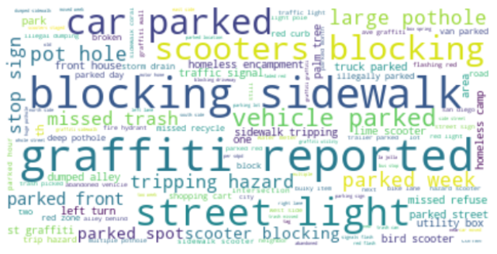
What are people reporting?
*Stop words removed

Slide 7
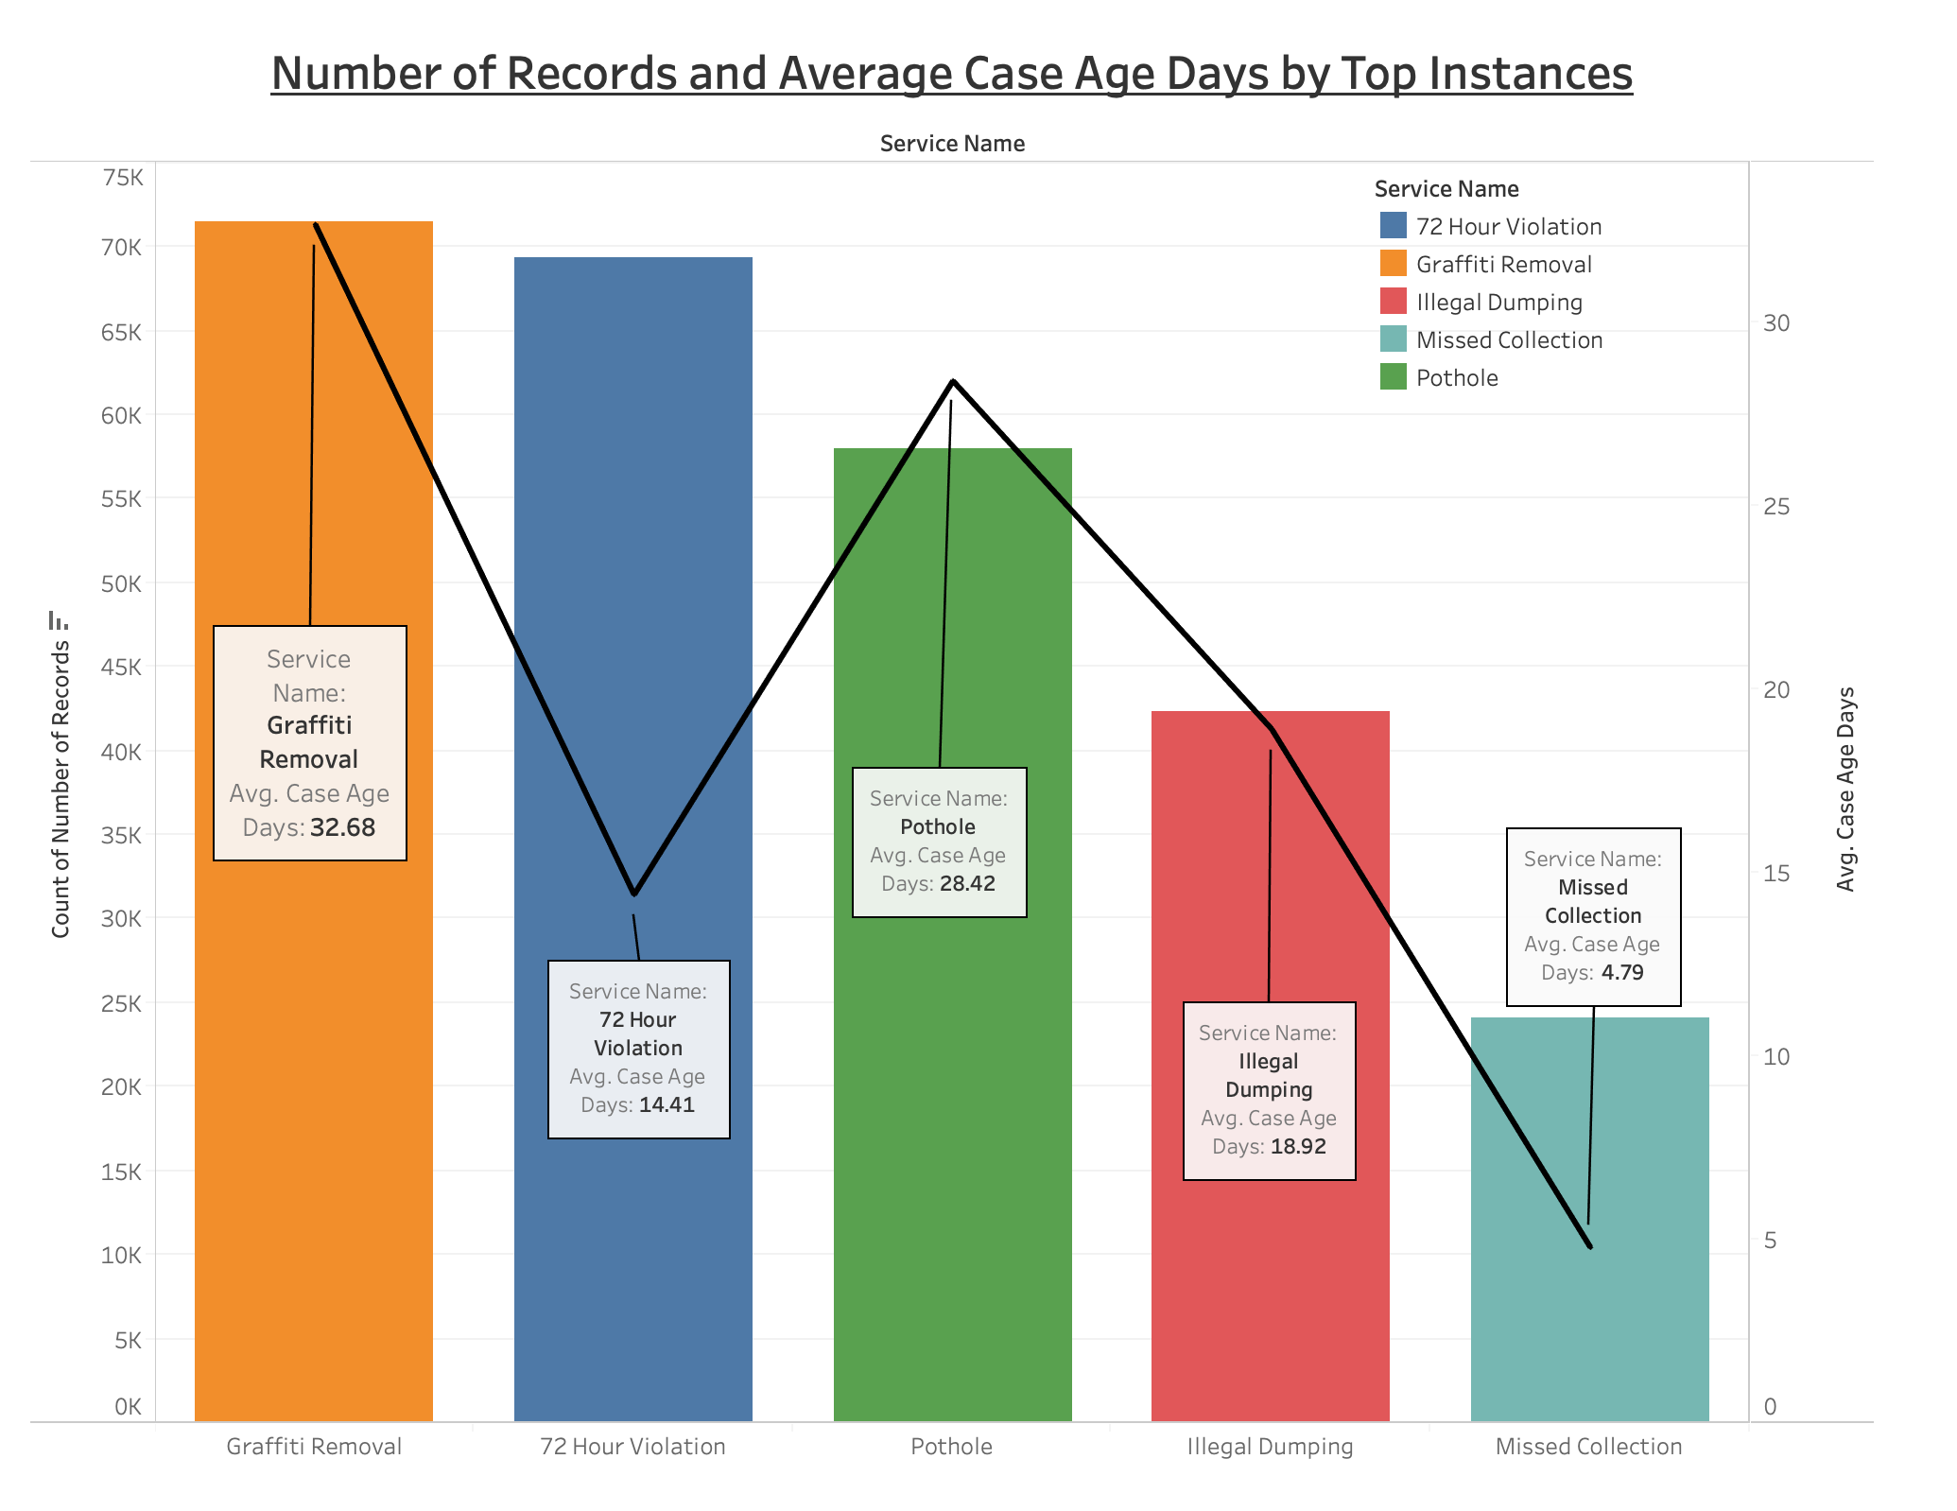
Top 5 Cases (since launch)

Slide 8

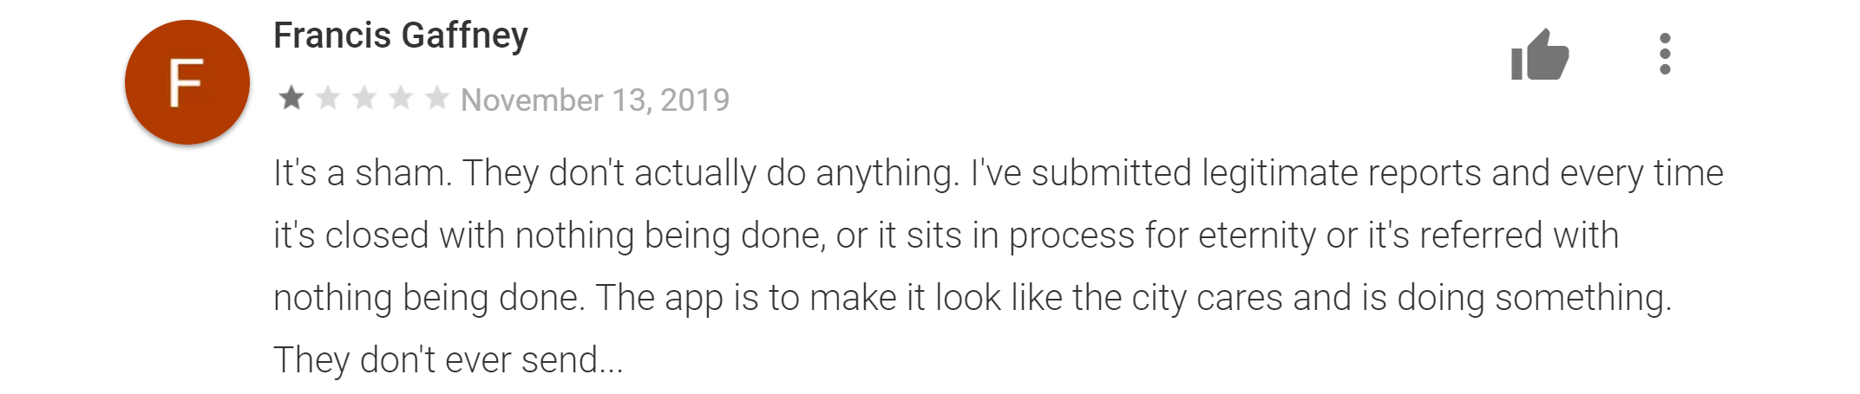
What are people saying about “Get it Done!”?
Play Store: 3.8
App Store: 3.8

Slide 9
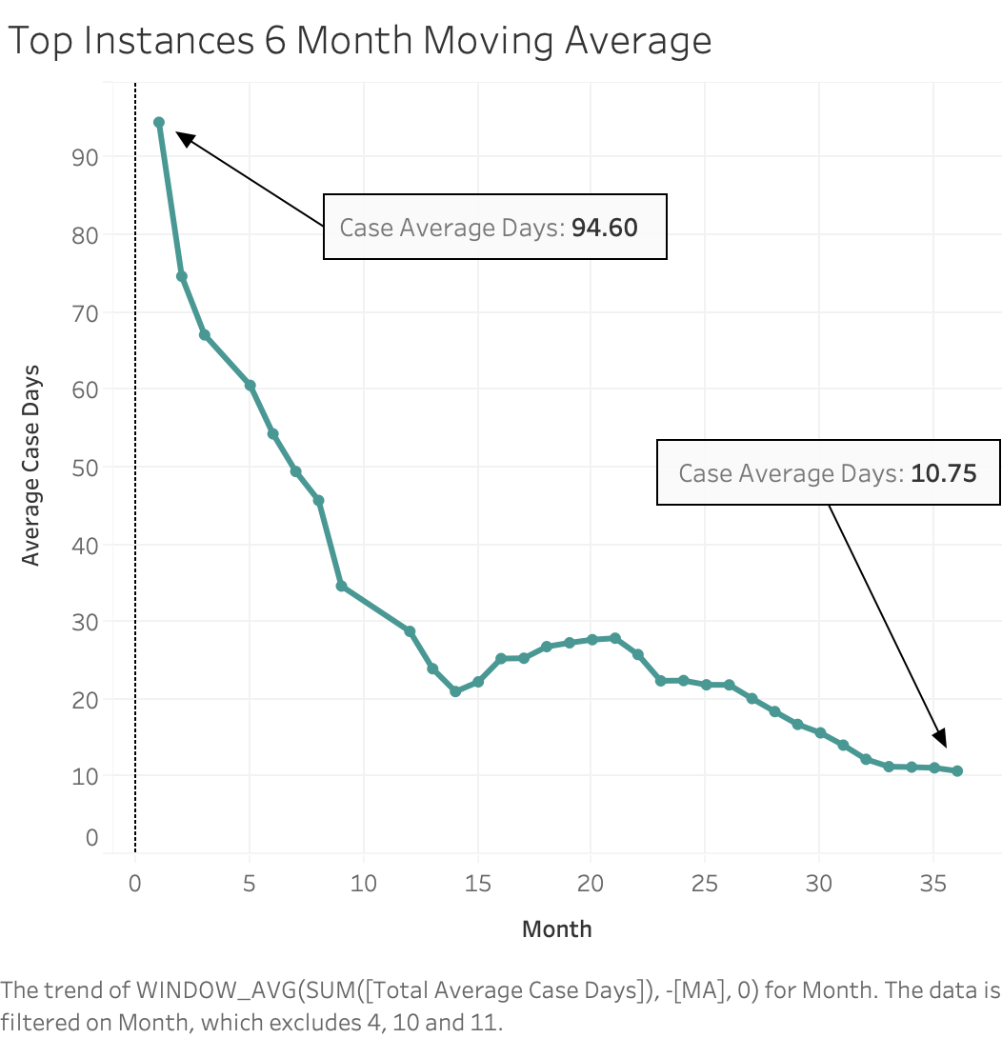
Decreasing Trend for Case Times
2017
2018
2019
Notes:
Use as last/one of last slides to emphasize that with the adoption of this program, they’ve really improved themselves, and subsequently, improved the city of San Diego

Slide 10
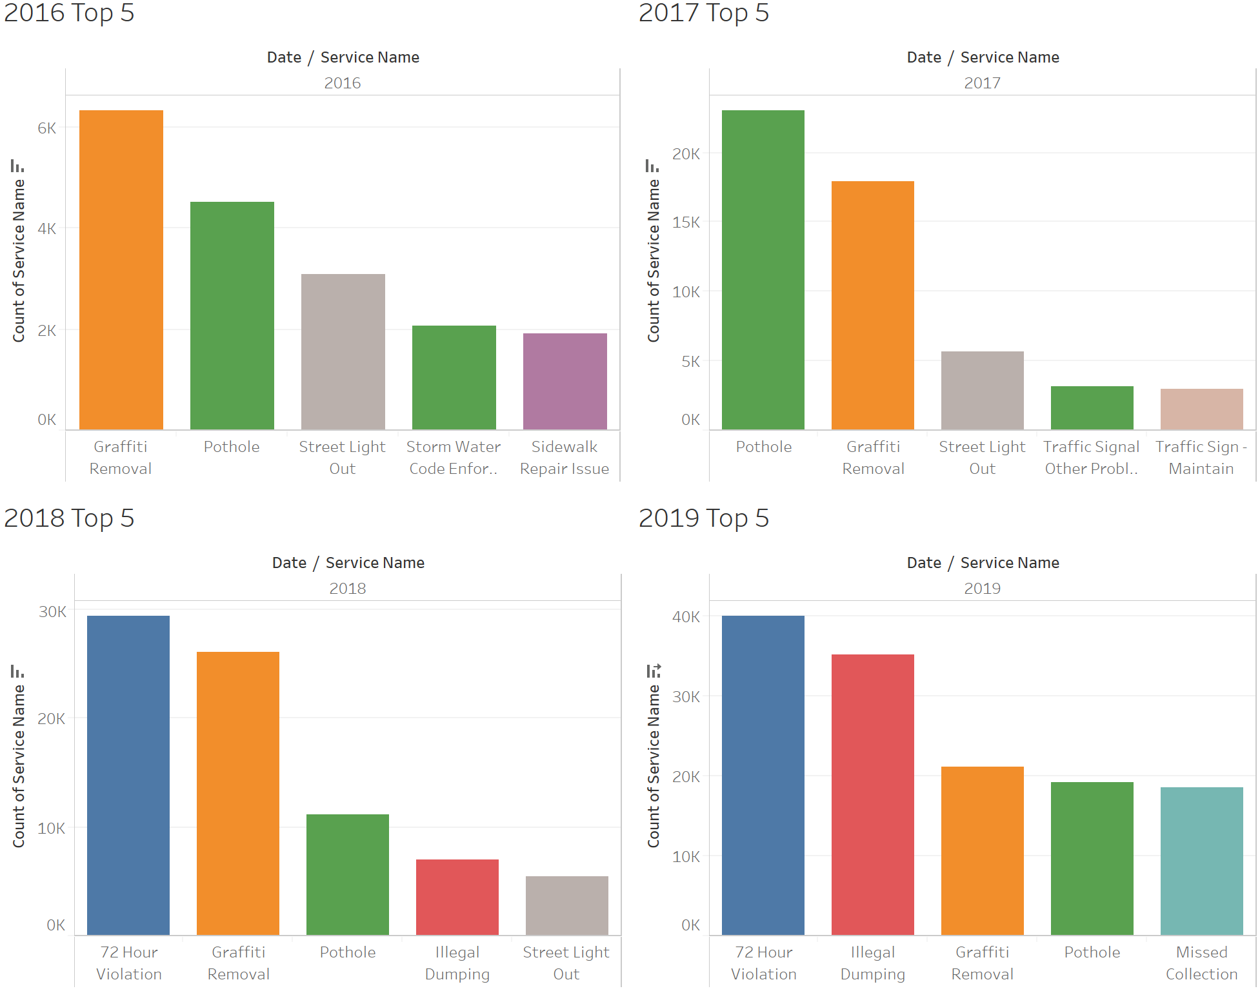
How have the most common cases changed over time?

Slide 11
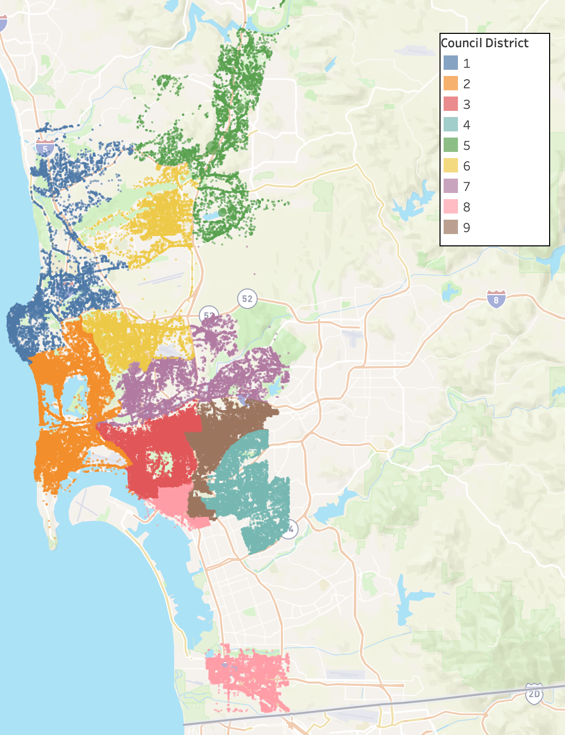
San Diego City Map
(By District)

Slide 12
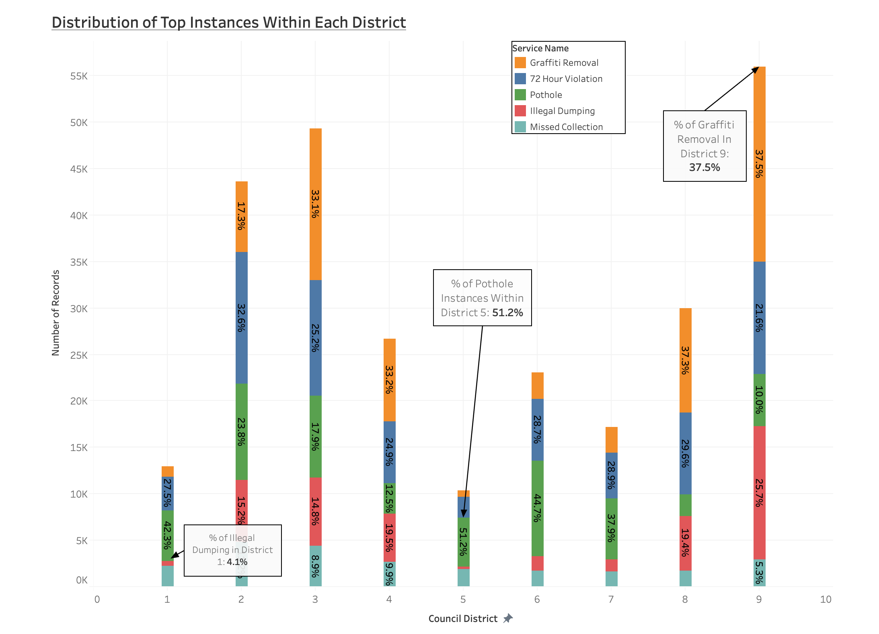

Slide 13
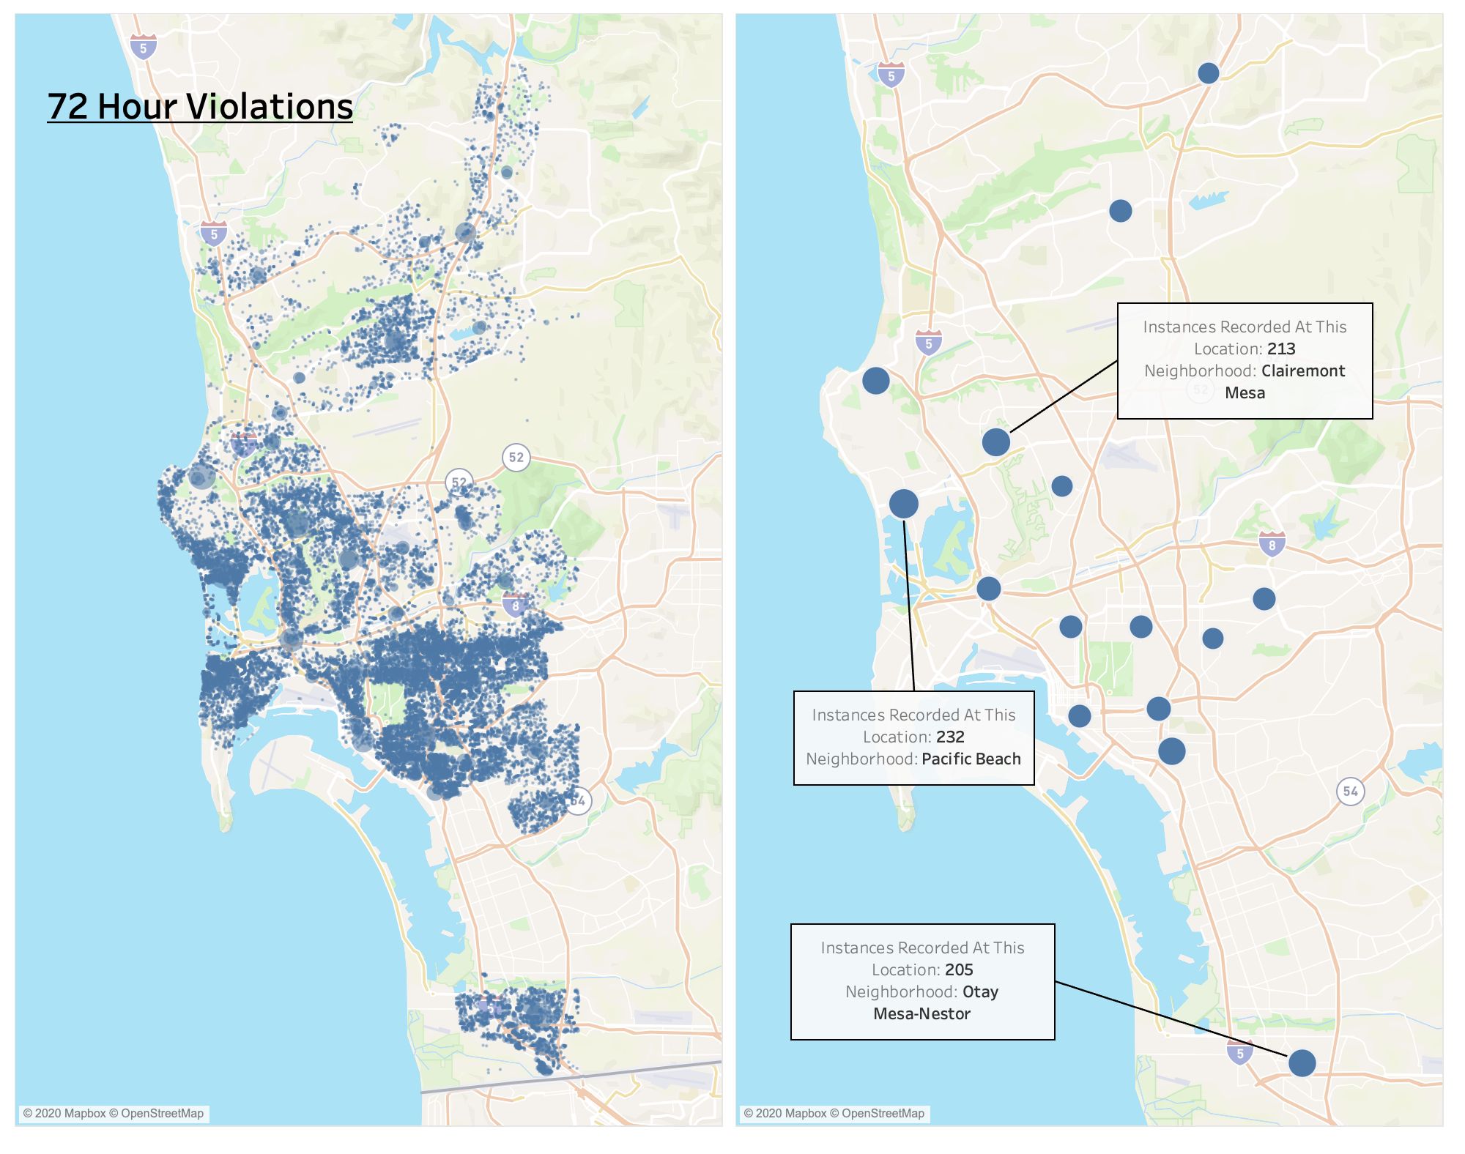
Large parking clusters all throughout the city

Slide 14
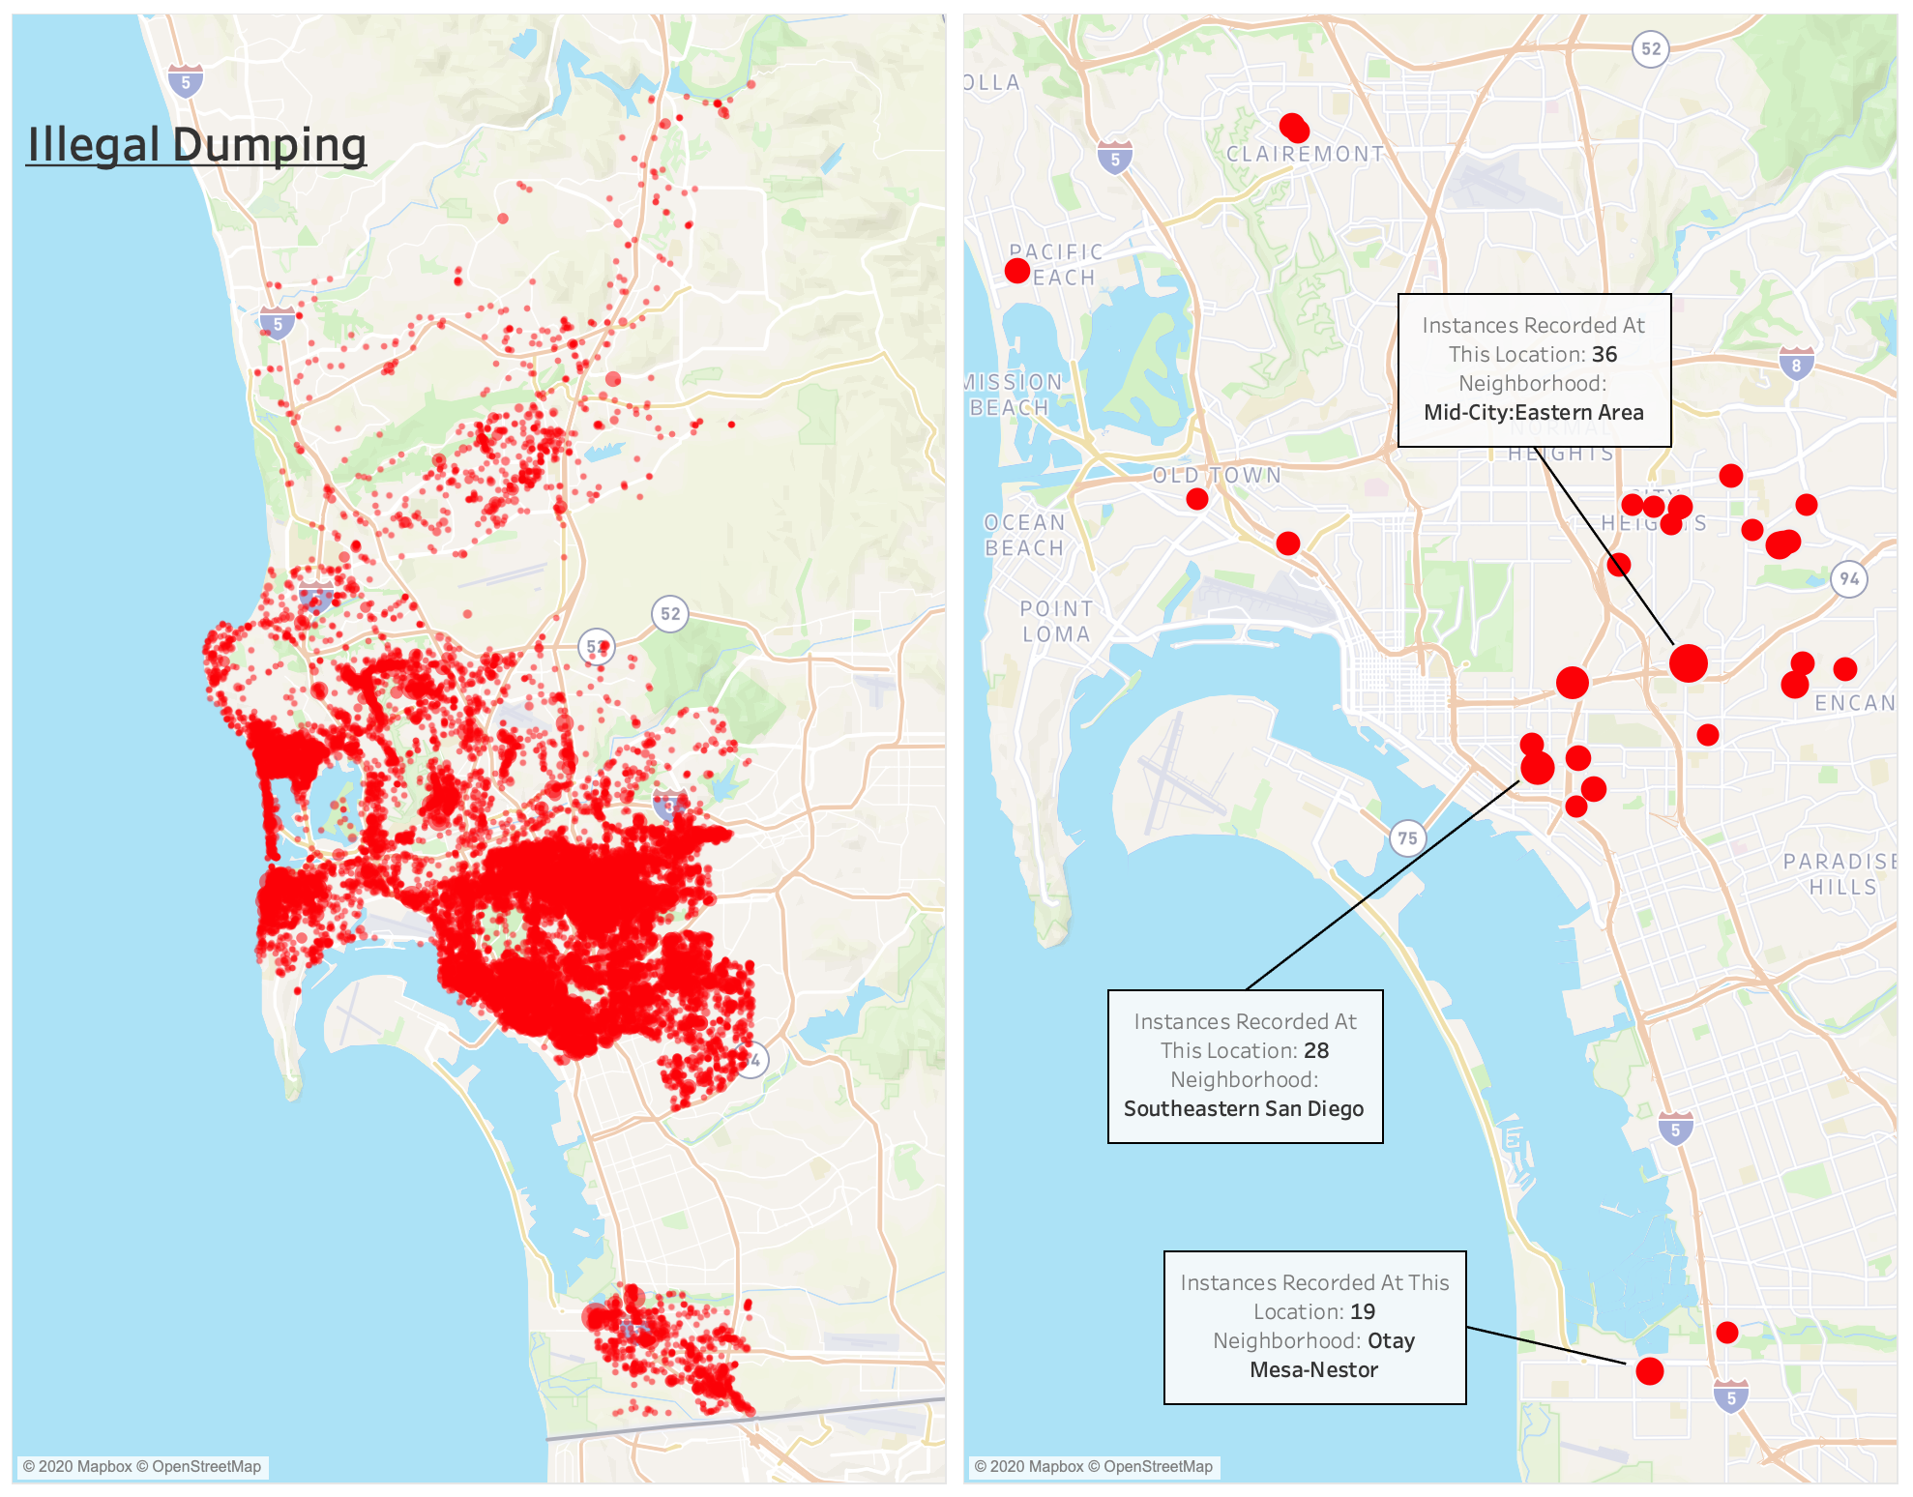
High cases of illegal dumping in the Mid-City area

Slide 15
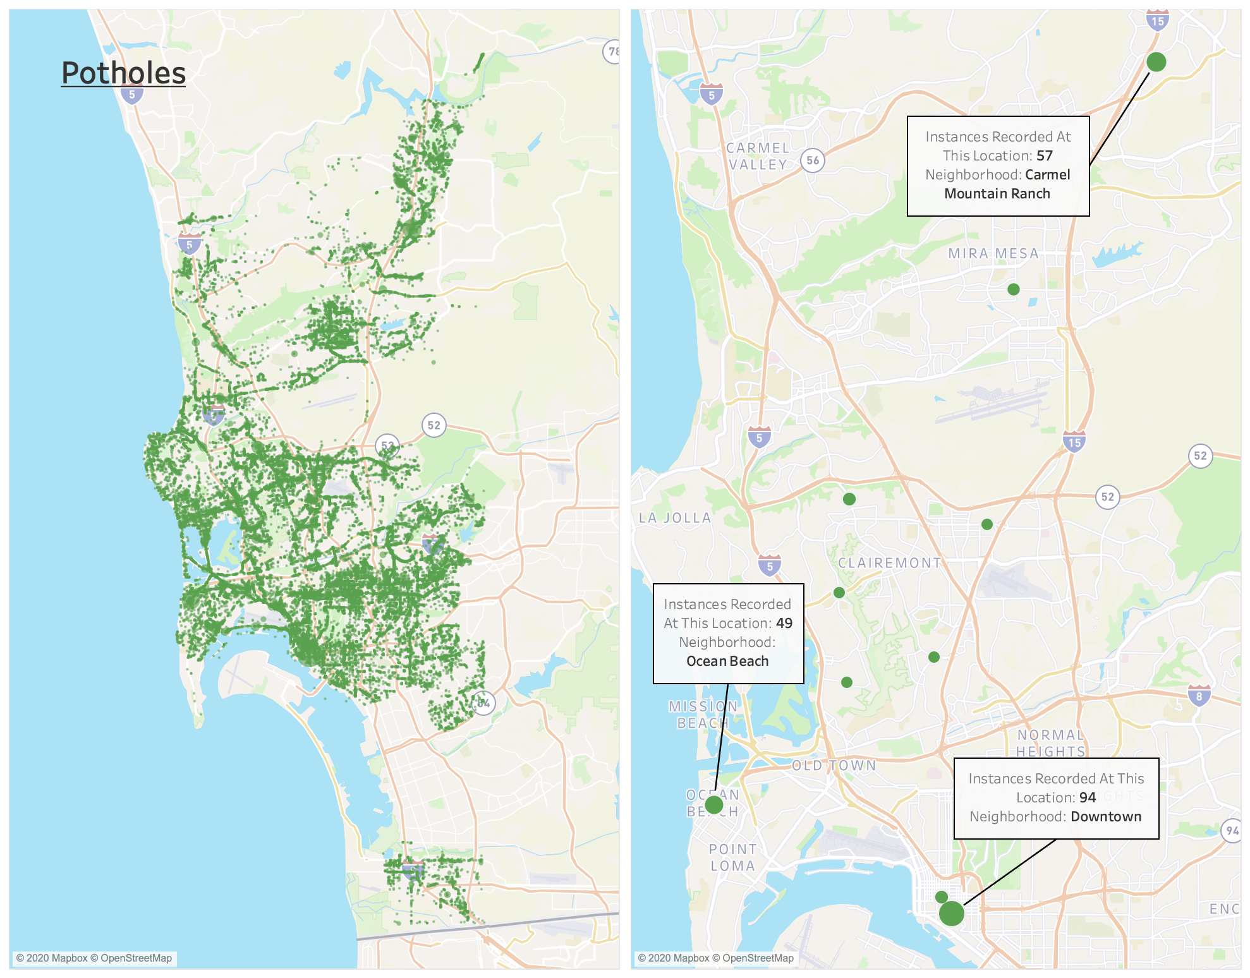
Pothole Cases Widespread

Slide 16
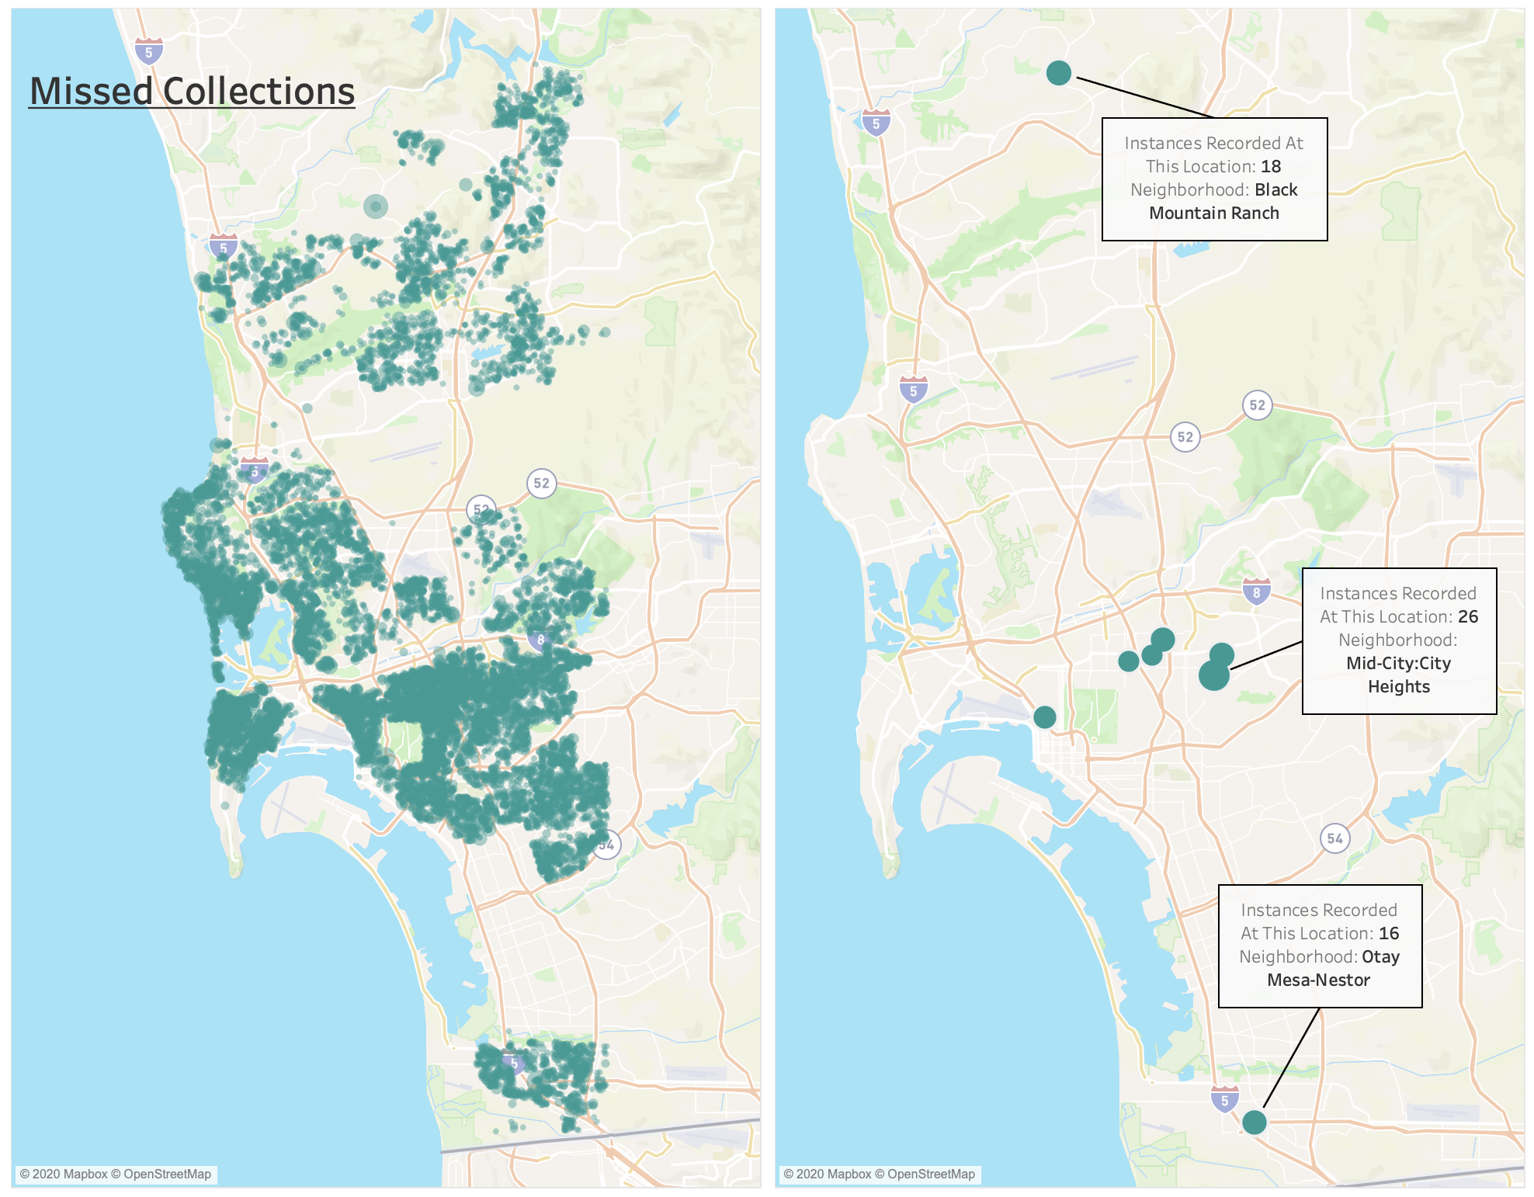
High missed collection concentrated in Mid-City

Slide 17
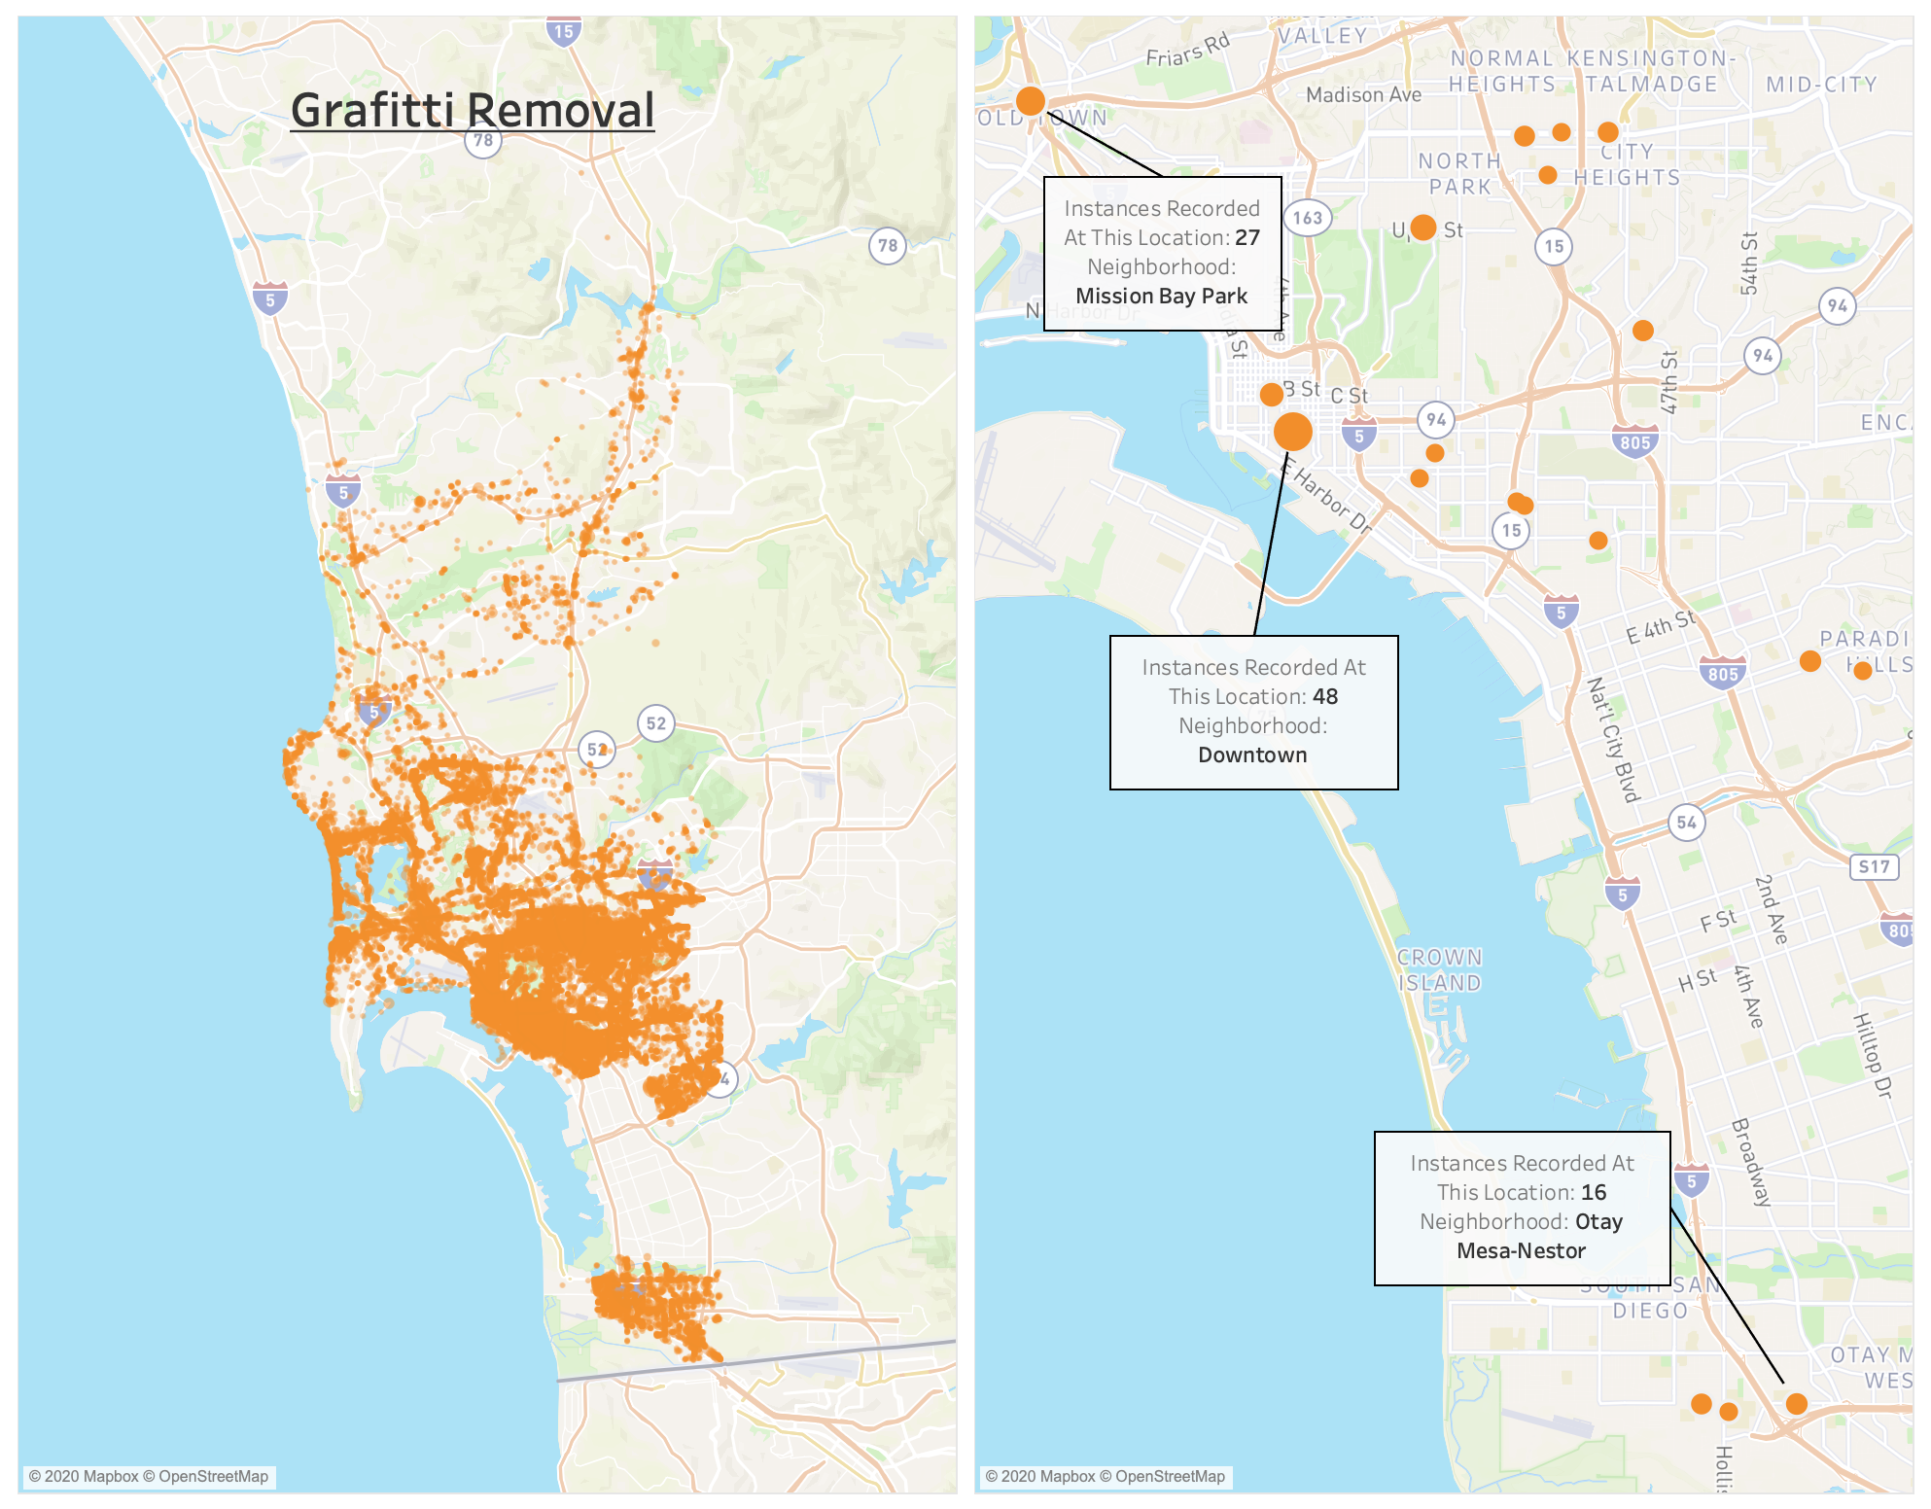
Repeated graffiti cases near the coast

Slide 18
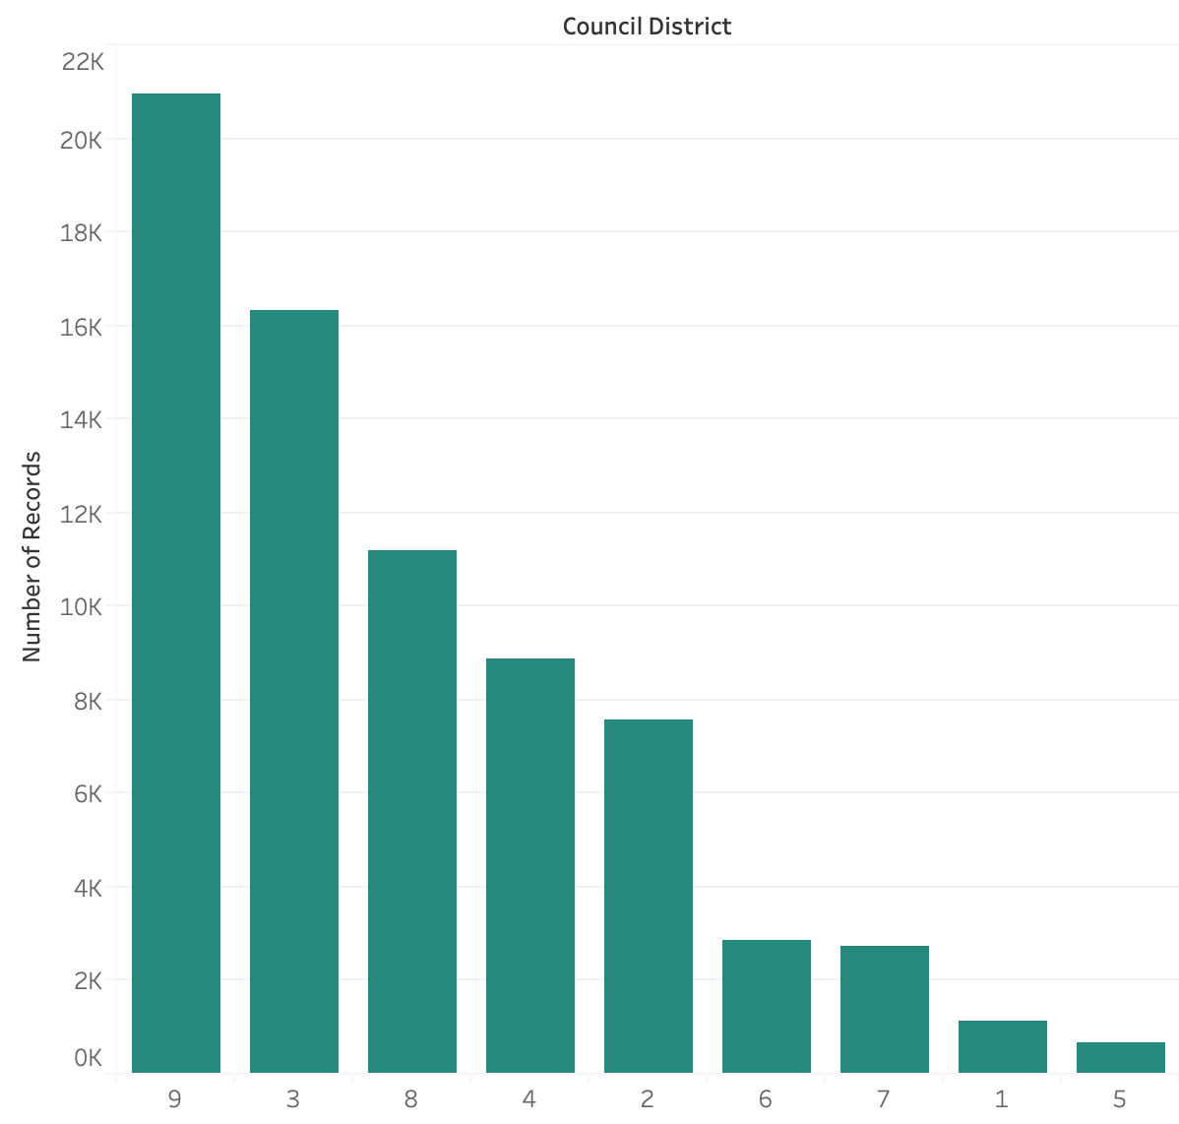
Most graffiti cases in districts 9, 3, 8
9 – 21,000
3 – 16,000
8 – 11,000

Slide 19
San Diego City Map
(By District)

Slide 20
Most graffiti cases in districts 9, 3, 8
9 – 21,000
3 – 16,000
8 – 11,000

Slide 21
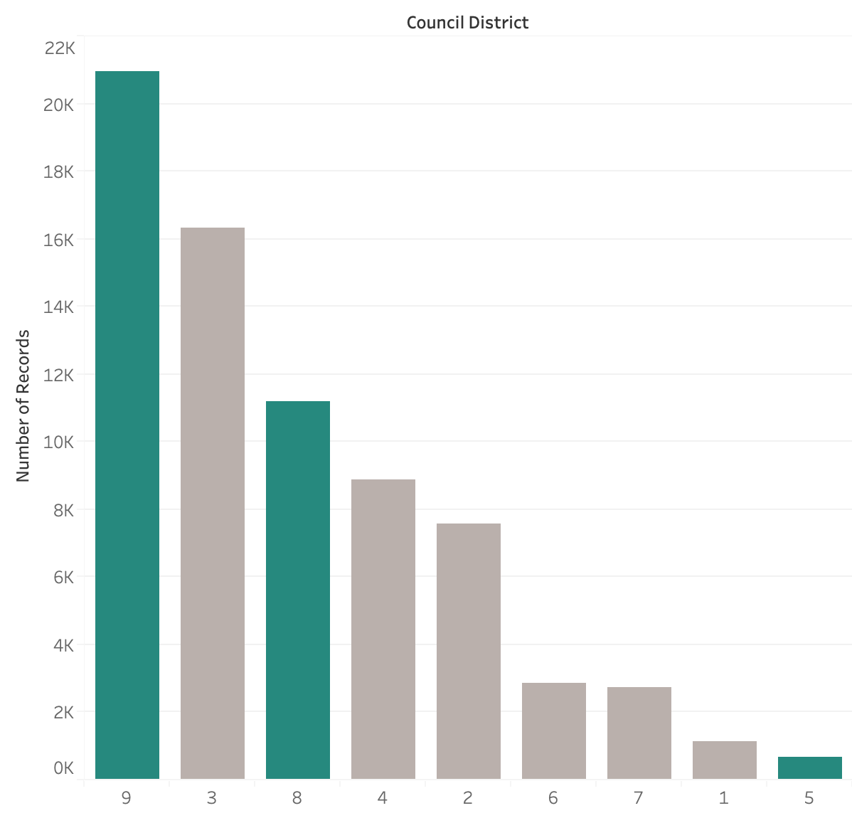
Highest Case Time in Districts 9, 5, 8
44.6
43.3
34.5
27.8
Notes:
Conclusion:
We see that district 9 has the most graffiti and takes the most time to fix (41.59)
District 3 has the second most cases but only takes 28 days on average to clean up graffiti.
Why is this happening?
Perhaps because the city hall is located in district 3. This means that they can respond faster to cases faster
Council members are more likely to see graffiti and are more likely to report it bc they are councilmembers
District 9 - highest for both
Why - not as clean as other cities
Graffiti cleaning questions
Who does the removal?
Is there one cleaner per district or do they all come from one centralized location?

Slide 22
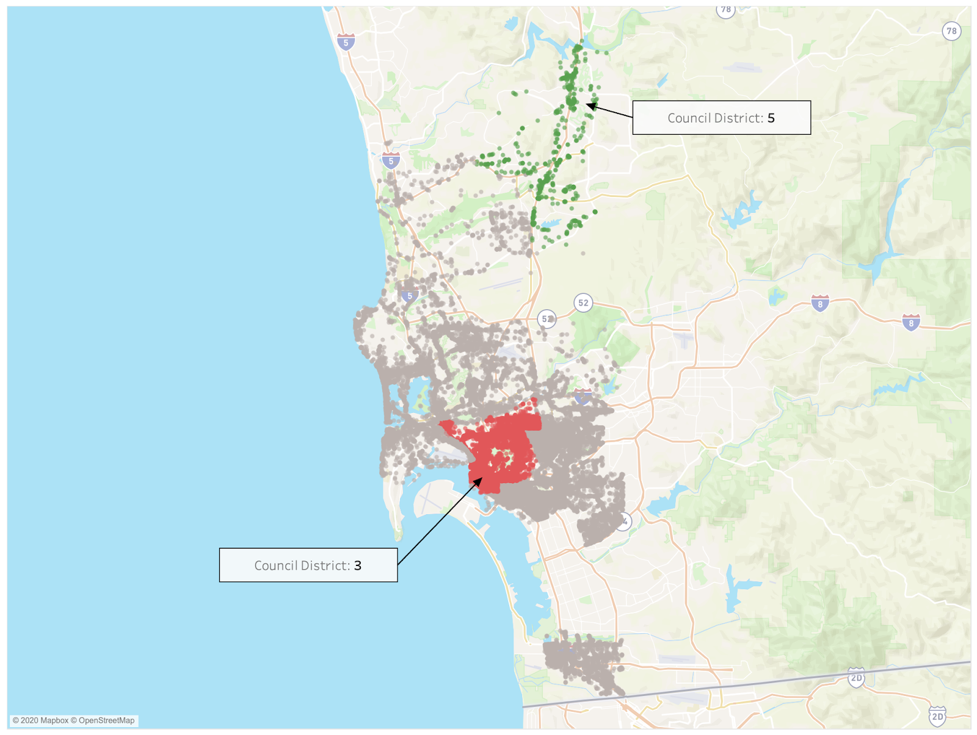
Distance may be a key factor in graffiti case time
Graffiti Operations Yards

Slide 23
Geographical Location
Small Crew for all of SD (8 people)
More Graffiti cases that take longer
Scheduling contractors takes time
Leaving Graffiti longer encourages more Graffiti

Slide 24
Models

Slide 25
Models
Allocate Resources Better
Goal:
Predict what case will occur given certain circumstances
Save time and money
Determine the drivers of different cases

Slide 26
Model Preparation
Data Cleaning
Transform Variables
Columns
Stratified Split
Removed Test observations
Month
Season
Time of Day
Day of the Week
Normalized Latitude and Longitude
Test (30)
One hot encode categorical variables
Train (70)
Lat and Long
Notes:
Pre-Processing
Dropping Public description when importing into weka
Changing month numbers into month names
Only examining closed cases
Group Case-Age days
0-2 - Short
3-8 - Medium
8-30 - long
31+ - very long
Filter out latitude and longitude to city of San Diego
Machine Learning Analysis
Random Sample of 10,000 data from our filter data set of 130,000
Change District number to District name
Max interoperability

Slide 27
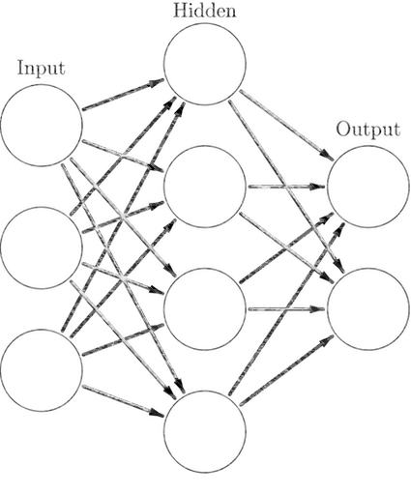
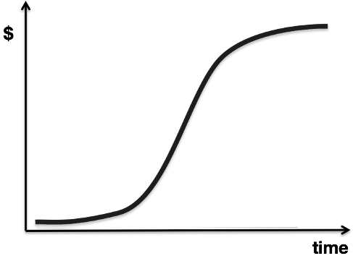
Neural Network
(NN)
Neural Network
(NN)
Multinomial Logistic Regression (MLR)

Slide 28
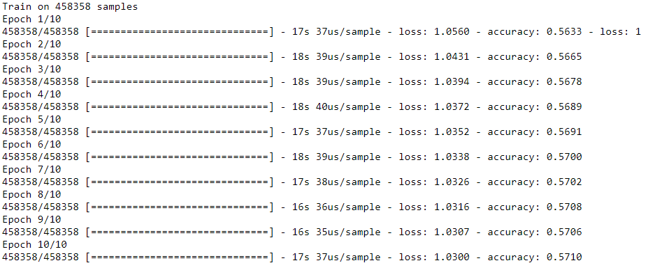
Neural Network

Slide 29
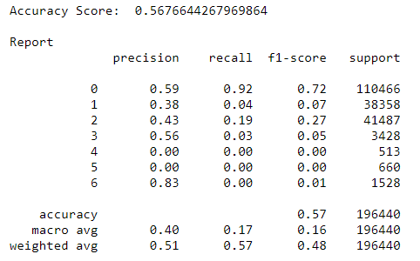
Neural Network

Slide 30
Neural Network

Slide 31
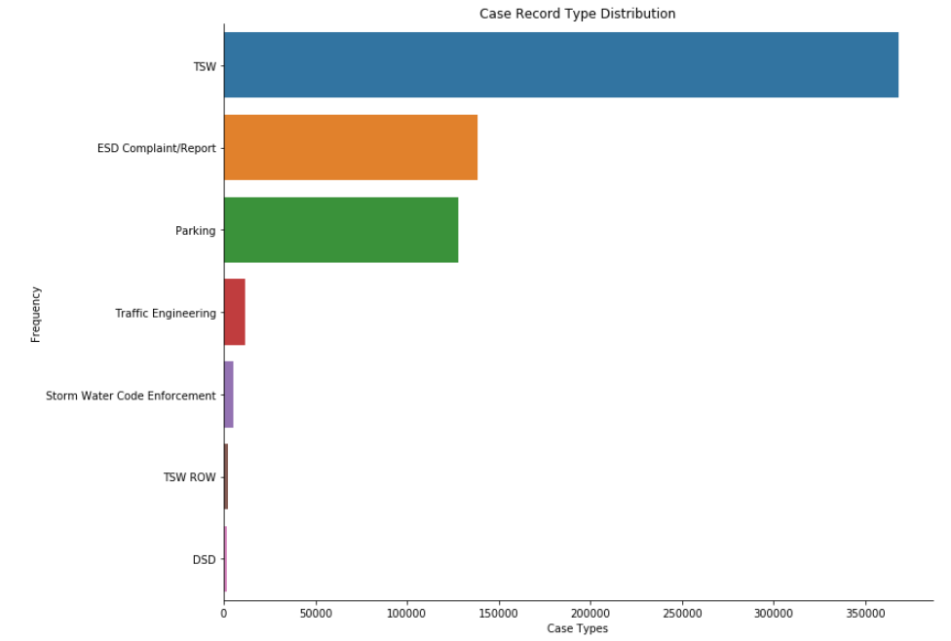
Uneven case distribution interferes with Model Accuracy
- Smote
- Near-Miss

Slide 32
Uneven case distribution interferes with Model Accuracy
0
2
1
3
6
5
4
- Smote
- Near-Miss

Slide 33
Uneven case distribution interferes with Model Accuracy
SMOTE
- Smote
- Near-Miss

Slide 34
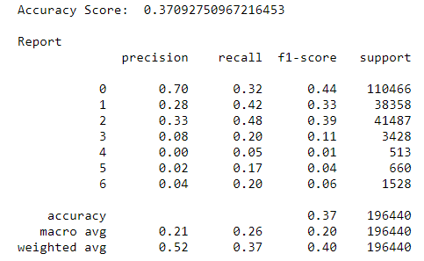
Uneven case distribution interferes with Model Accuracy
SMOTE
- Smote
- Near-Miss

Slide 35
Uneven case distribution interferes with Model Accuracy
SMOTE
- Smote
- Near-Miss

Slide 36
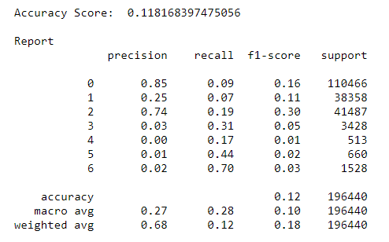
Uneven case distribution interferes with Model Accuracy
SMOTE
Near-Miss
- Smote
- Near-Miss

Slide 37
Uneven case distribution interferes with Model Accuracy
SMOTE
37%
Near-Miss
12%
- Smote
- Near-Miss

Slide 38
Multinomial Logistic Regression

Slide 39
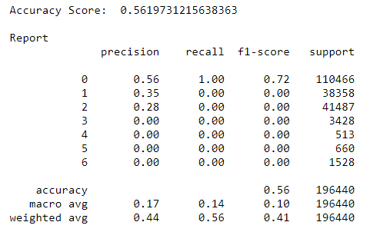
Multinomial Logistic Regression

Slide 40
Multinomial Logistic Regression
Neural Network

Slide 41
Category | Service Name | NN | MLR | Benchmarks | Performance
Accuracy | Service Name | 56.8% | 56.2% | - | -
TSW | Graffiti, Pothole | 59% | 56% | 14% | 3.9x
Parking | 72 Hour Violation | 38% | 35% | 14% | 2.4x
Env. Service Dep. | 72 Hour Violation, Missed Collection, Illegal Dumping | 43% | 28% | 14% | 2x
Traffic Eng. | - | 56% | 0% | 14% | 3.9x
Dev. Ser Dept. | - | 0% | 0% | 14% | -
TSW ROW | - | 0% | 0% | 14% | -
Stormwater Code | Illegal Dumping | 83% | 0% | 14% | 5.8x

Slide 42
Category | Service Name | NN | MLR | Benchmarks | Performance
Accuracy | Service Name | 56.8% | 56.2% | - | -
TSW | Graffiti, Pothole | 59% | 56% | 14% | 3.9x
Parking | 72 Hour Violation | 38% | 35% | 14% | 2.4x
Env. Service Dep. | 72 Hour Violation, Missed Collection, Illegal Dumping | 43% | 28% | 14% | 2x
Traffic Eng. | - | 56% | 0% | 14% | 3.9x
Dev. Ser Dept. | - | 0% | 0% | 14% | -
TSW ROW | - | 0% | 0% | 14% | -
Stormwater Code | Illegal Dumping | 83% | 0% | 14% | 5.8x

Slide 43
Problem with Neural Networks

Slide 44
Problem with Neural Networks
We don’t know how the weights are being adjusted at each epoch.

Slide 45
Problem with Neural Networks
We don’t know how the weights are being adjusted at each epoch.
Use Forest of Trees to determine Feature Importance

Slide 46
Feature Ranking
Rank | Feature | Score
1 | Latitude | 0.41
2 | Longitude | 0.40
3 | Day of Week | 0.07
4 | Month | 0.03
5 | Time of Day | 0.02
6 | Community Plan Name | 0.02
7 | Season | 0.01
8 | Council District | 0.01

Slide 47
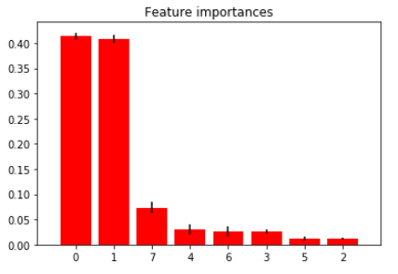
Feature Ranking
Rank | Feature | Score
1 | Latitude [0] | 0.41
2 | Longitude [1] | 0.40
3 | Day of Week [7] | 0.07
4 | Month [4] | 0.03
5 | Time of Day [6] | 0.02
6 | Community Plan Name [3] | 0.02
7 | Season [5] | 0.01
8 | Council District [2] | 0.01

Slide 48
Model in Action

Slide 49
Model in Action
Insert Parameters
Run the Model
Interpret Table

Slide 50
Model in Action
Insert Parameters
Friday, Council District 9, GPS Coordinates (32.70899, -117.11593), Winter, January, Via De La Valle, Afternoon
Run the Model
Interpret Table

Slide 51
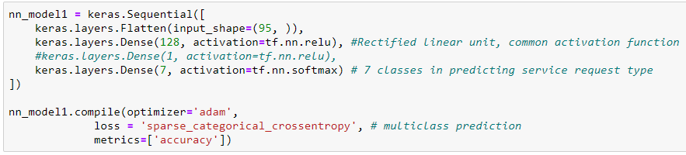
Model in Action
Insert Parameters
Friday, Council District 9, GPS Coordinates (32.70899, -117.11593), Winter, January, Via De La Valle, Afternoon
Run the Model
Interpret Table

Slide 52
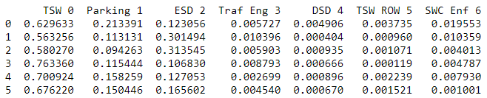
Model in Action
Insert Parameters
Friday, Council District 9, GPS Coordinates (32.70899, -117.11593), Winter, January, Via De La Valle, Afternoon
Run the Model
Interpret Table

Slide 53
For the full python code, repository can be found here: https://github.com/ryanluuwas/ML-SD-Project

Slide 54
Recommendations

Slide 55
Key Insights
5. Distance, small crew and hiring contractors all add to Graffiti case length
1. Overall, case times have been trending down since the app launch
3. Longitude and Latitude are the most significant variables in predicting case record type
2. Shared Mobility Devices are common complaints in case reporting
4. Multiple requests for same exact latitude and longitude

Slide 56
Recommendations
Predict where and when cases will happen
Better prepare associated departments to deal with cases
Reporting an issue for a shared mobility device should be as easy as reporting a pothole
Many complaints about shared mobility devices
Add more “Get it Done!” tracked metrics to the PerformSD Dashboard
Increased transparency and increase positive sentiment among citizens

Slide 57
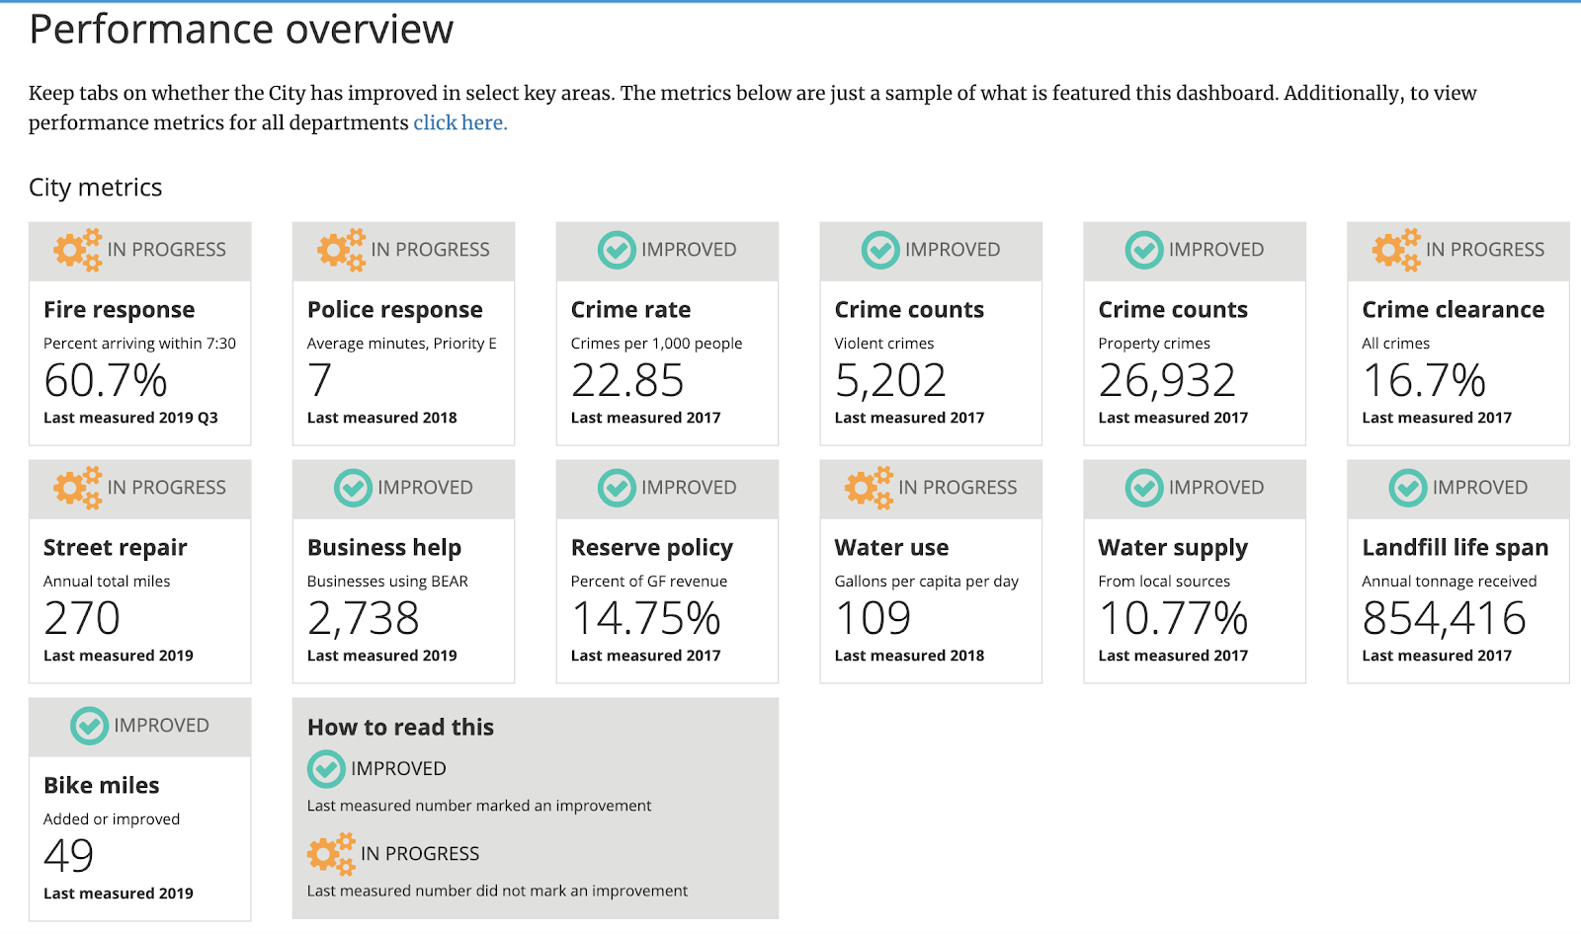

Slide 58
Thank You!

Slide 59
Q/A

Slide 60
Appendix

Slide 61
Data Cleaning I
Variables Changed
Date
Month
Date Requested
Time
Season
Time of Day
Word Cloud Prep
Remove ‘Test Observations’ and ‘Stop words’ from Public Description
We made sure all of the requests were from the city of San Diego (made sure the latitude and longitude are within SD).

Slide 62
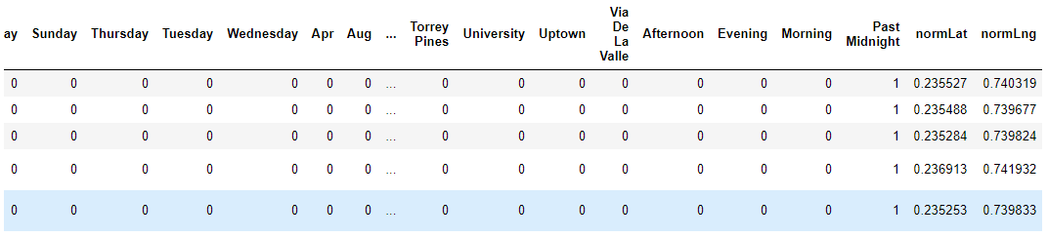
Model Prep In Depth
Convert Case Record Type to Integers (TSW = 1, Parking = 2, etc.)
Normalized Latitude and Longitude
One hot encoded day of the week, month, season, council district, case origin, comm plan name, time of the day.
Dropped leftover/unneeded date requested, case age days, service names, date_uploaded, status, latitude, longitude, comm_plan_code, park_name, public description, date, time.

Slide 63
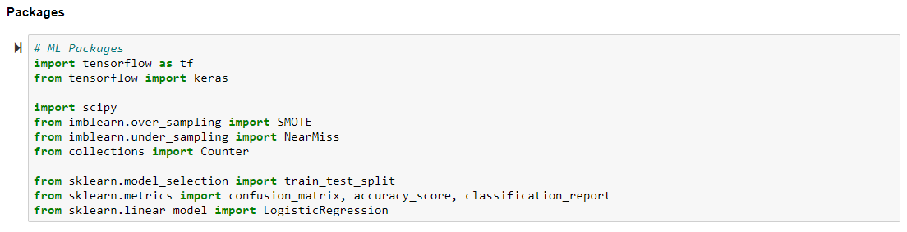
Packages Used
Sklearn’s Train_test_split for Stratified Split
Imblearn’s SMOTE and NearMiss for Sampling
Tensorflow’s Keras for Neural Network
Sklearn’s Logistic Regression for Multinomial Logistic Regression
Sklearn’s Metrics to evaluate the model’s performance

Slide 64
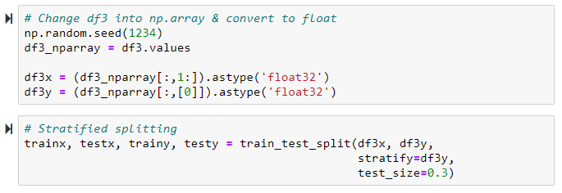
Hold-Out Method for train and testing
Create train and test set. Train the model with the train set and evaluate the model’s performance with the test set.
70% of the dataset will be moved to Train set.
30% of the dataset will be moved to Test set.
We will be using sklearn’s stratified train/test split.

Slide 65
Machine Learning Models

Slide 66
Service Name Reference
Case Record Type: A higher-level grouping of service names that corresponds to the City staff group responsible for responding to the request.
0. Transportation and Storm Water - TSW (Graffiti Removal, Potholes)
1. Parking (Vehicles Parked Over 72-hours, car parked in red zone)
2. Environmental Service Department - ESD Complaint/Report (Illegal Dumping)
3. Traffic Engineering (Street Light Out, Traffic Signal Timing)
4. Development Service Department - DSD (Code enforcement, Safety Risks)
5. TSW ROW (Reviews, Permits, and Inspects for Quality Assurance)
6. Stormwater Code Enforcement (Over Irrigation)

Slide 67
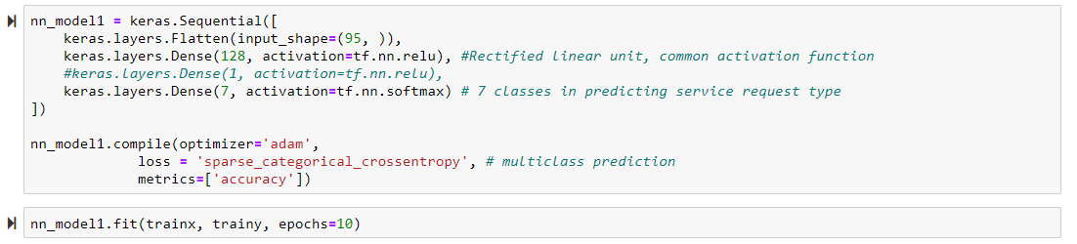
Neural Network

Slide 68
Neural Network

Slide 69


Slide 70
Uneven Record Distribution Warranted Resampling Methods
Smote – Undersampling
Near Miss - Oversampling

Slide 71
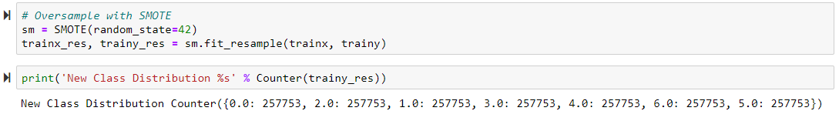

Synthetic Minority Oversampling Technique (SMOTE)

Slide 72
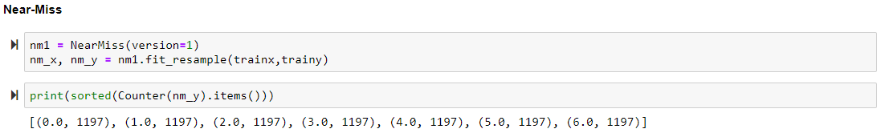

Near-Miss

Slide 73
Rebalancing Results
Although there were slight improvements utilizing SMOTE, it created too much noise in the model and significantly reduced the accuracy of the other majority classes.
Using Near-miss to undersampled the dataset lead to too much information loss and was unable to properly train the model.
As a result, we decided to not use any resampling methods in our model

Slide 74

Multinomial Logistic Regression

Slide 75
Neural Network
Multinomial Logistic Regression
Despite such similar accuracy score, the Neural Network Model sports better overall precision. Despite stratified splitting, it is important to note that there are not that many 4,5,6 class instances to properly ‘test’ the model

Slide 76
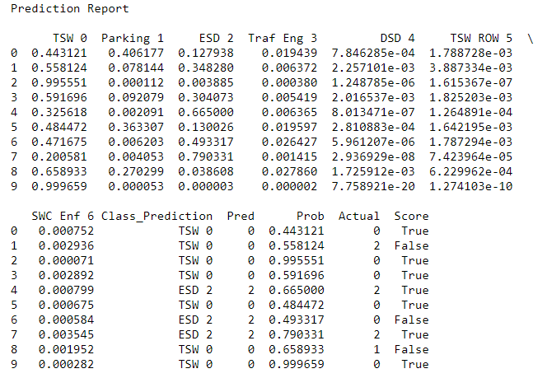
Neural Network Model in Test Data Set

Slide 77
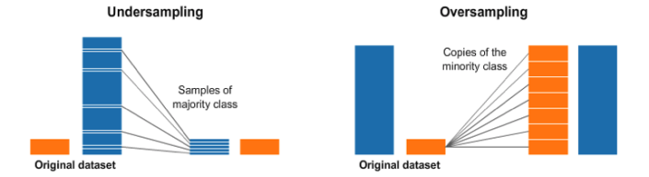
Undersampling and Oversampling explained

Slide 78
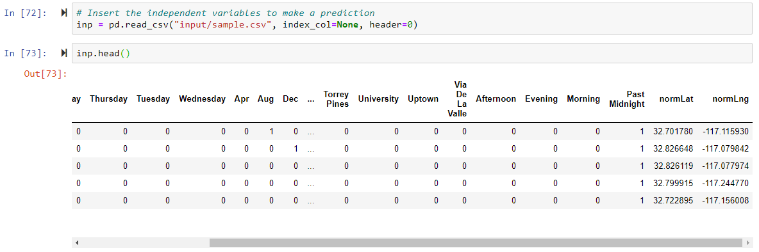
Model Application I
1. Fill in Sample Variables in

Slide 79
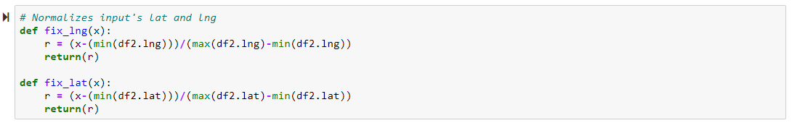
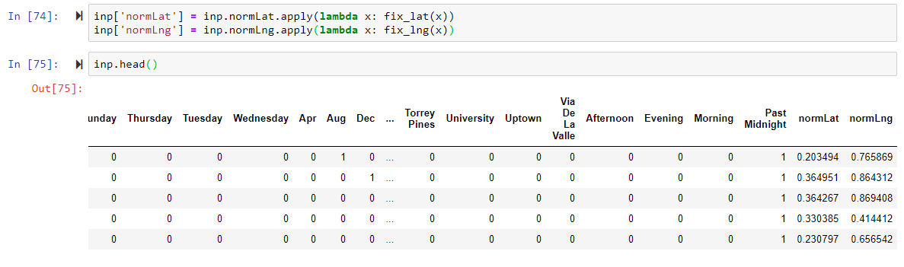
Normalize the Longitude and Latitude against the original dataset’s Latitude and Longitude that trained the model.

Slide 80
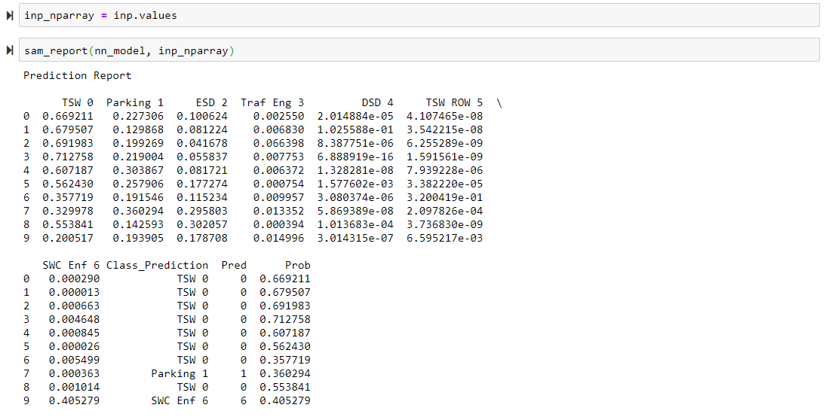
Prediction Table on the Sample file.

Slide 81
Miscellaneous

Slide 82
Additional Info
Highest number of cases and highest average case time
Focusing on Public Graffiti problems
After talking with people the graffiti department, we determined the problem is not an issue of distance to the case but an issue of not having enough people to do the job. 8 person crew for the whole city
They have are considering hiring contract workers for spikes in workloads
But there is a delay. If they get 150 cases on Monday and then reach out to contractors on Tuesday, it may take until the end of the week or longer for the contractors to start helping the case. This is a key driver of Graffiti Demand
If we could help predict demand of Graffiti and other cases, then we could help improve SD’s resource allocation
district 5 for graffiti
comes thru the supervisor - 50-150 a day
opening up work orders
determine public vs commercial vs private
urbancore - private contractor for all private abatements
Use salesforce to record everything
commerical - code compliance sections. physically check since sometimes businesses clean it themselves. it is the business responsibility to clean it up.
Public - field crew - 8 person crew - 2 north and 2 south
Several operations yards off 94 highway caminito challas
Central yard on dt and one in pacific beach
3 total
more of a staffing issue
50-75 per day

Slide 83
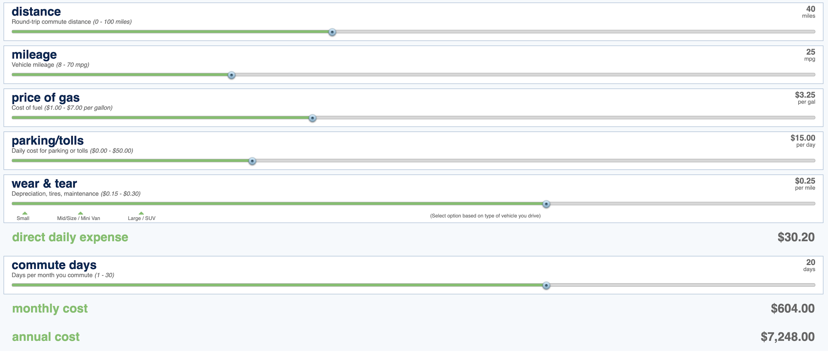
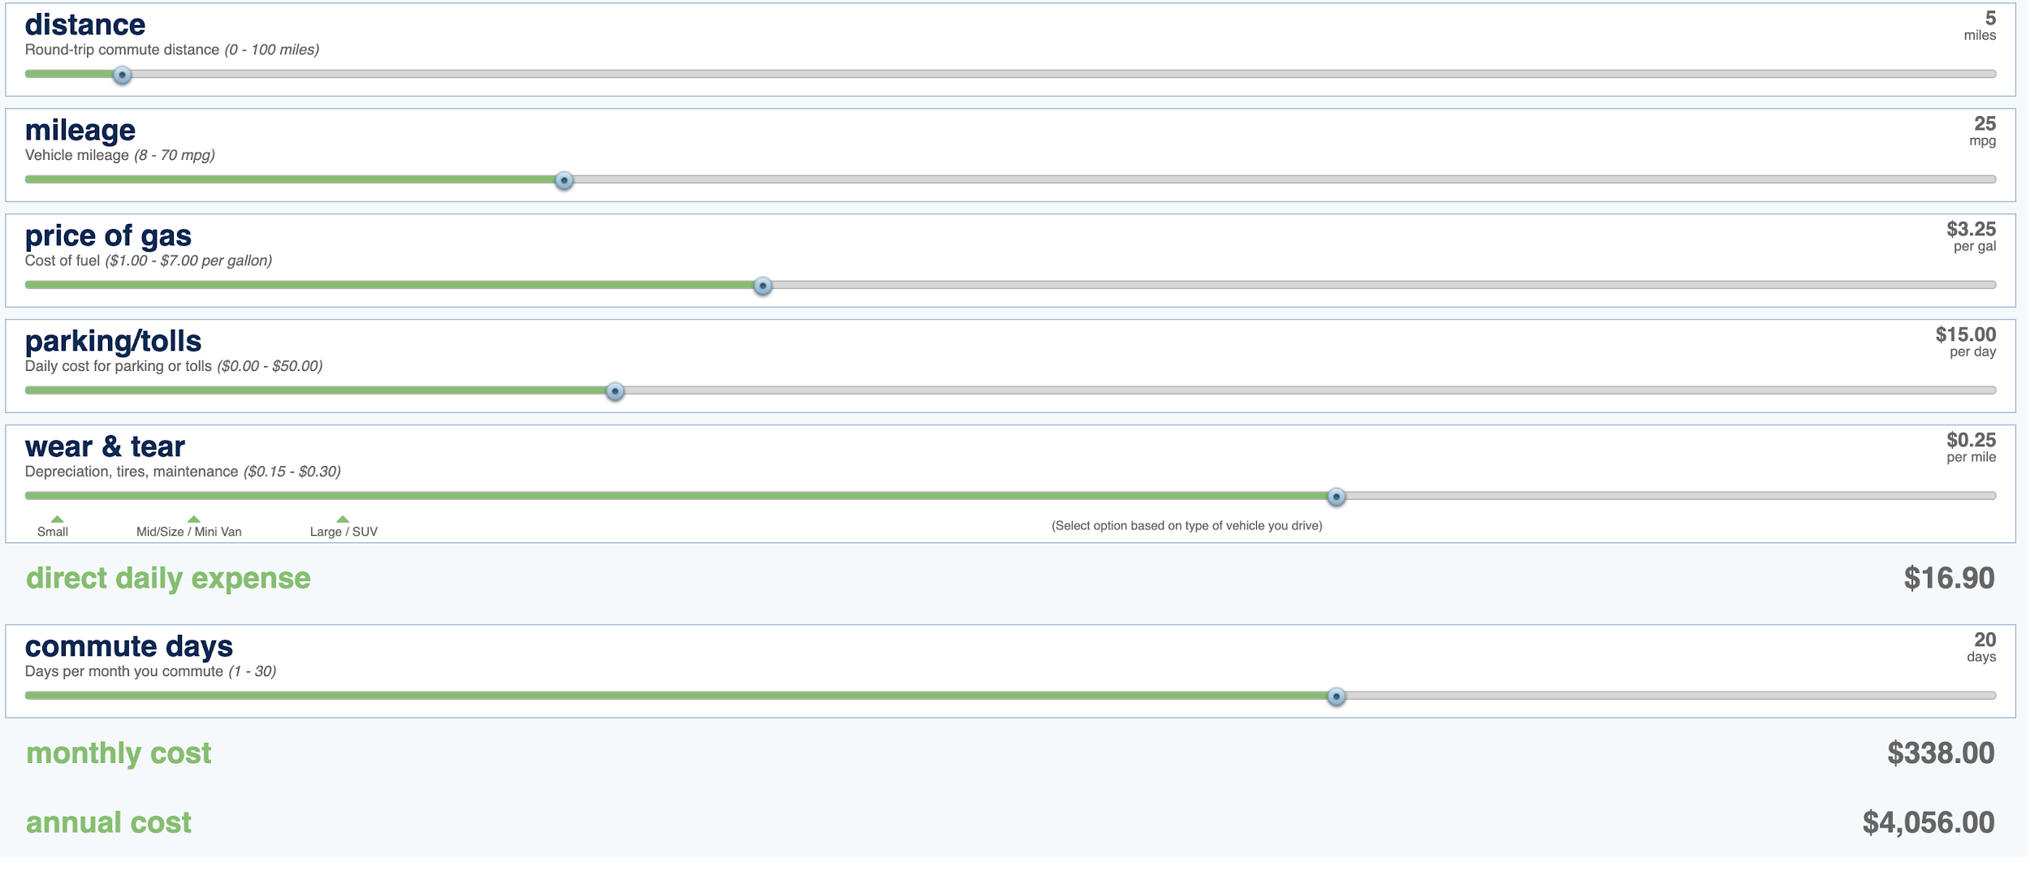
Notes:
This is just from a wear and tear calculator. Top image is showing how far they’d have to go to just service the stuff in North SD versus how little they have to drive when they service things in just downtown SD. The amounts by themselves don’t really matter, but it’s almost double the cost in order to service those far away places with how they do it now. So this probably contributes to why they service less over there, but the cost of not having a station closer to over there is adding up + the social cost of the unhappiness of residents in North SD.
Try to calculate social cost of graffiti removal. In order to combat graffiti, the best ways are to catch the tagger in the act, or to remove it quickly. Removing it quickly shows intolerance to graffiti and won’t let them enjoy the “fruits of their labor” for long.

Slide 84
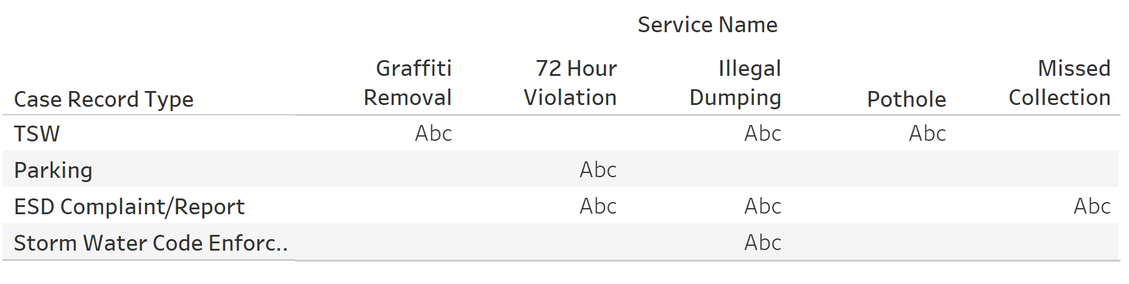
Service Names in Case Record Type

Slide 85
Why do we care?
Decrease in App Satisfaction
City
Allocate Resources
More Efficiently
Users
Feel like their problem gets heard
Both
Faster solutions
Less App Usage
Fewer Problems Reported

Slide 86
How do we define Long and Short?
Reasoning:
Easily Interpretable
Relatively Even Split
Short
Long
≤ 1 Week
> 1 Week
Notes:
Recall: Out of all the longs in reality, how many did our model predict correctly?
Precision: Out of all the longs that our model predicted, how many were true in reality?
Which is more important? - Recall
Our analysis is for the City
We want them to be aware of the issues taking a long time
We want to know out of how many cases that are actually long, how well does our model do?

Slide 87
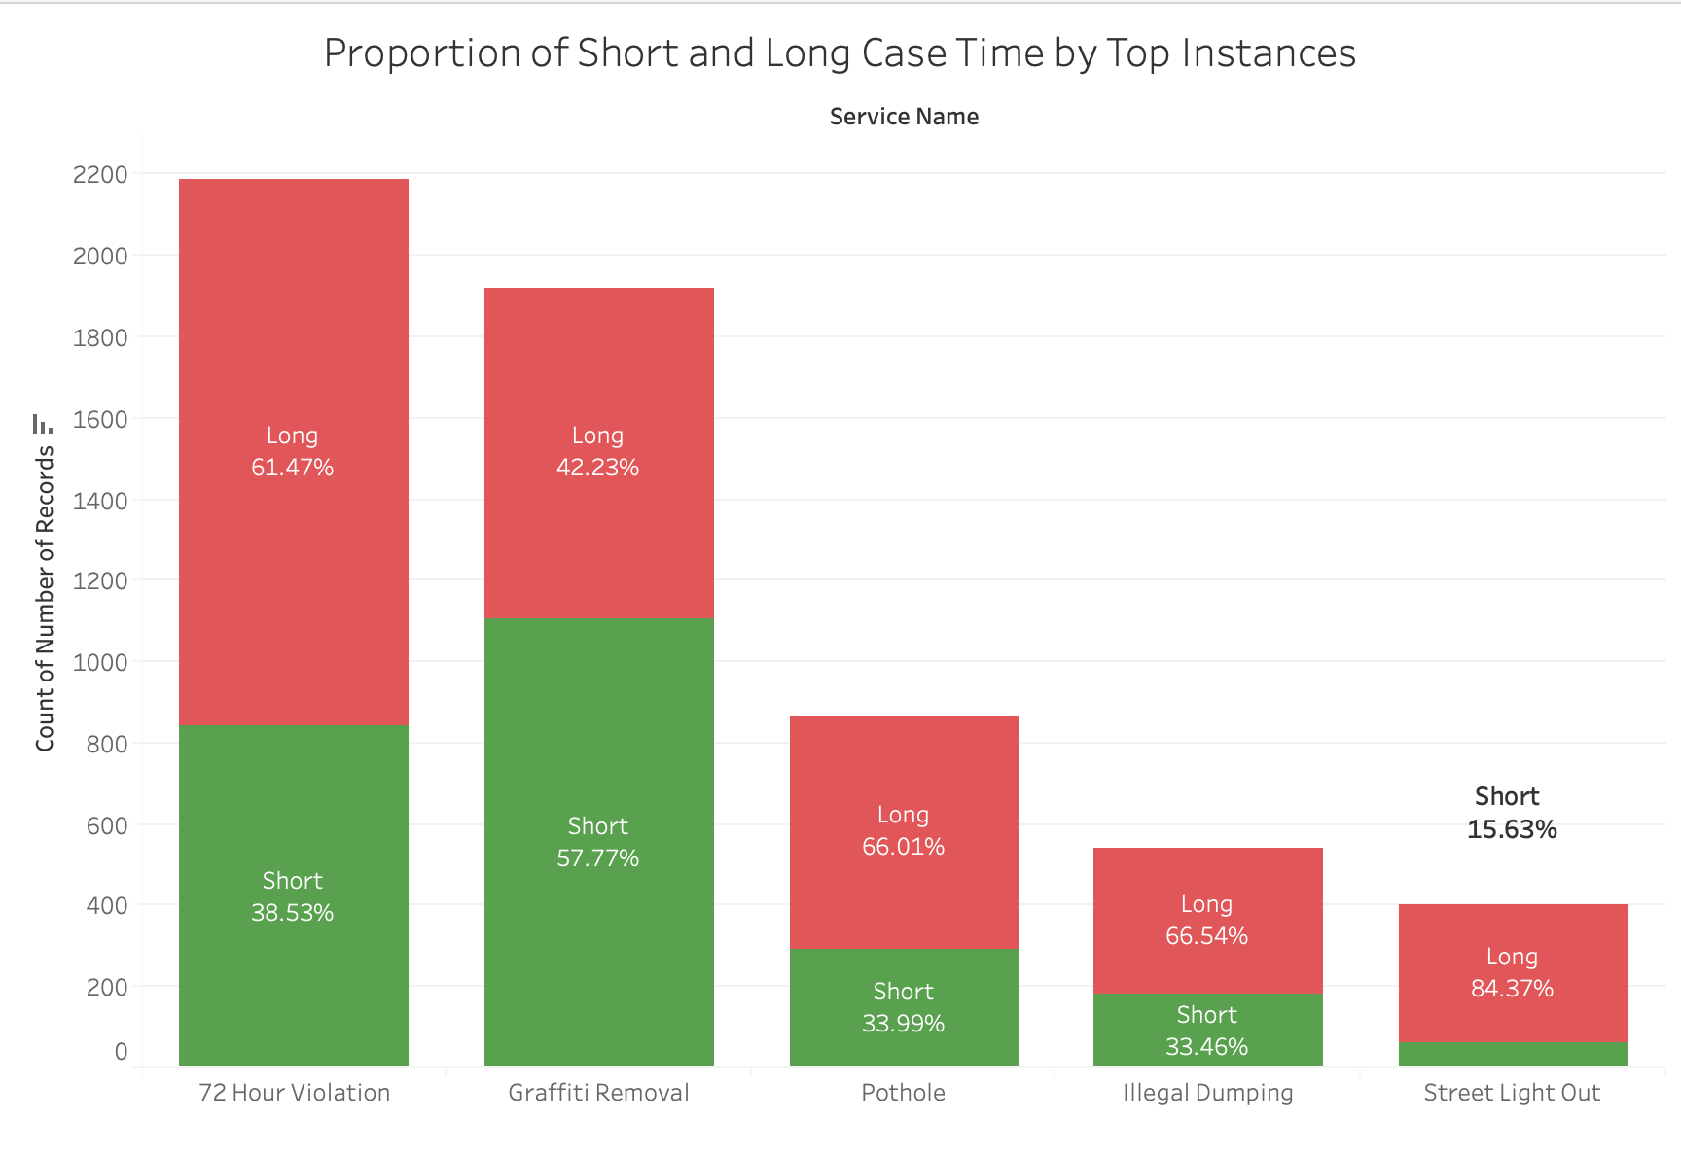
Total Proportion:
Long: 55.35%
Short: 44.65%

Slide 88
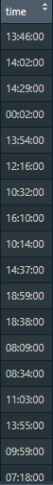
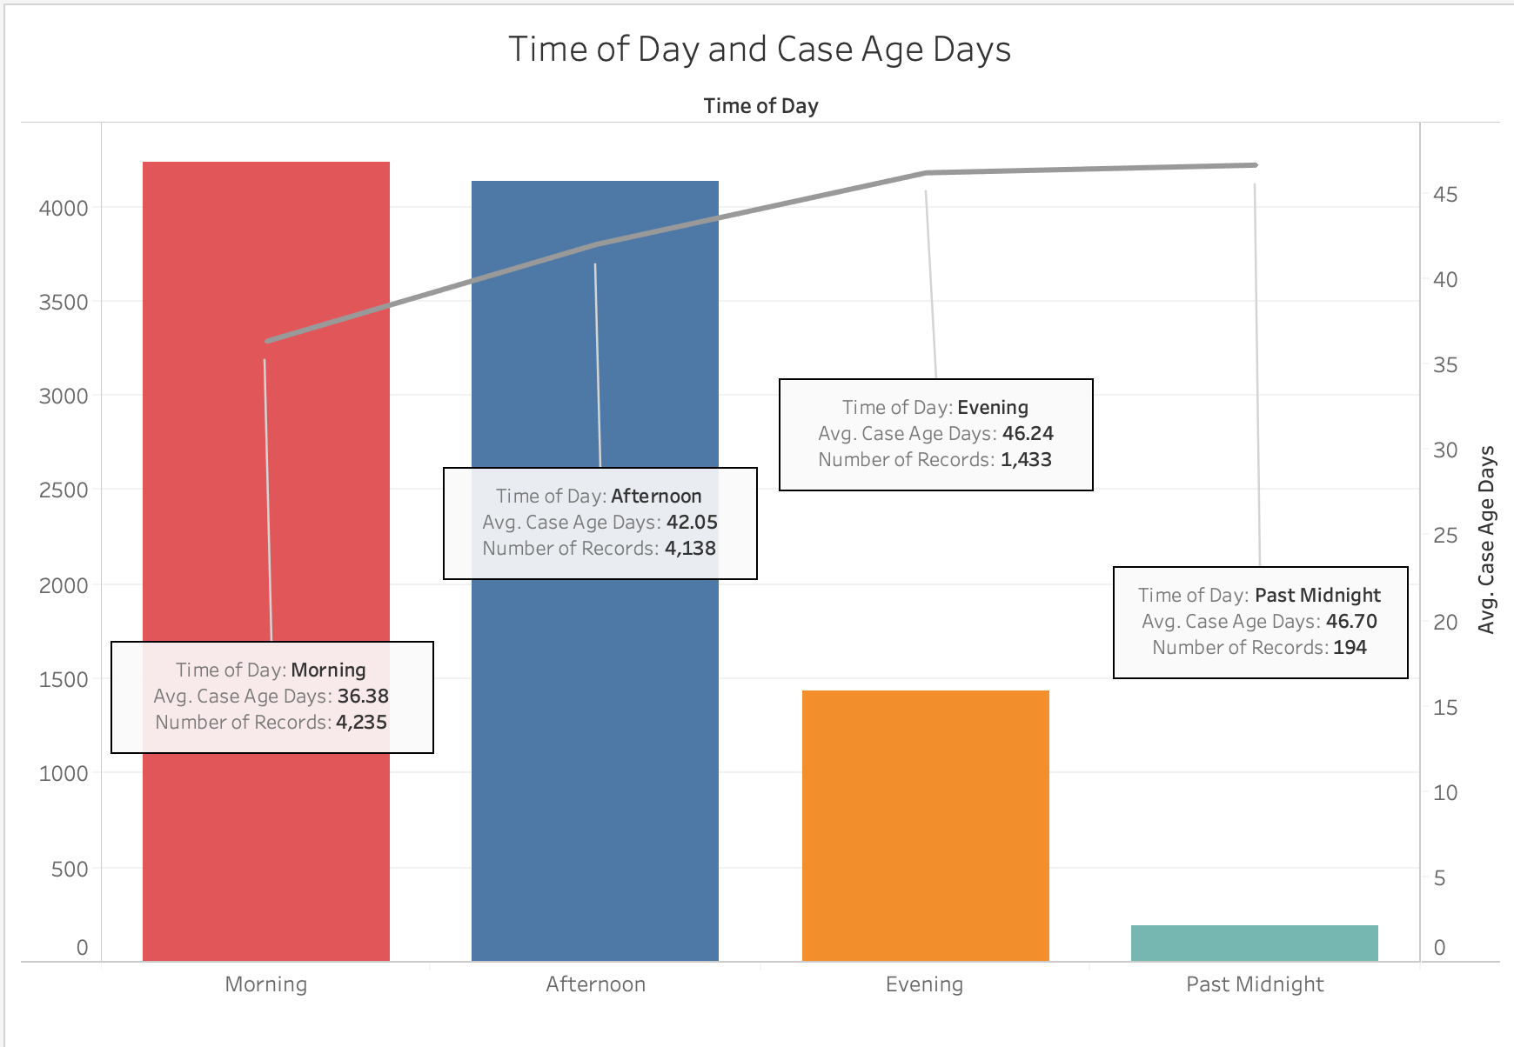
Transform: Time to Time of Day

Slide 89
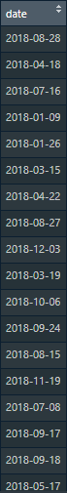
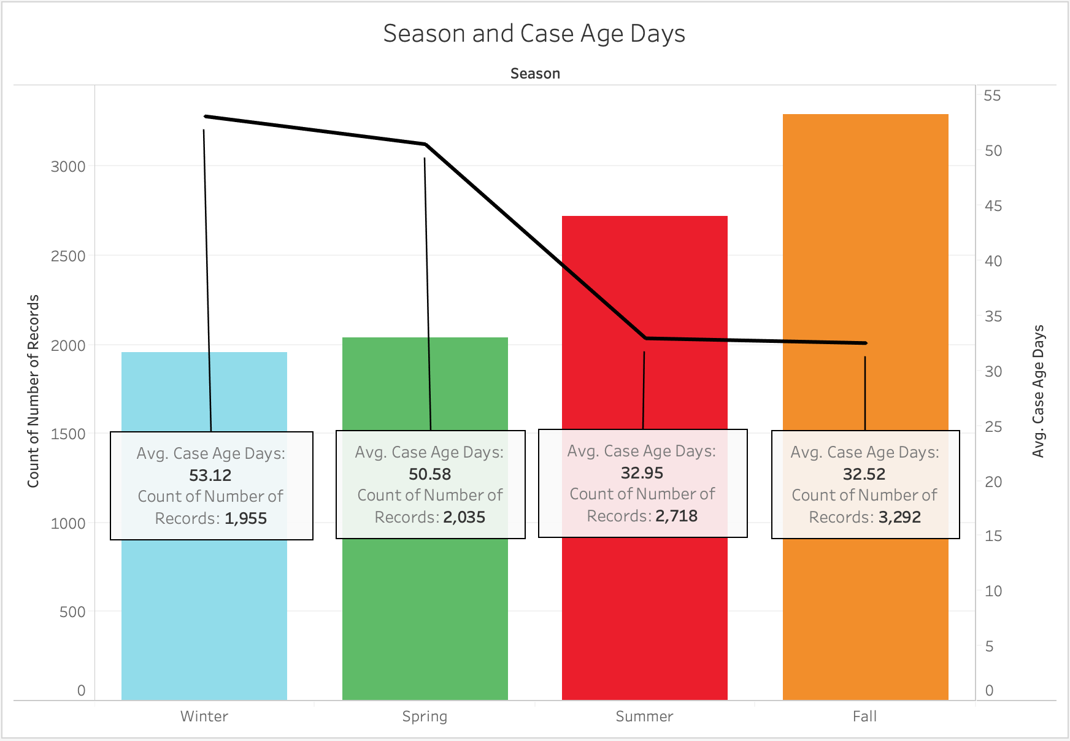
Transform: Date to Seasons

Slide 90
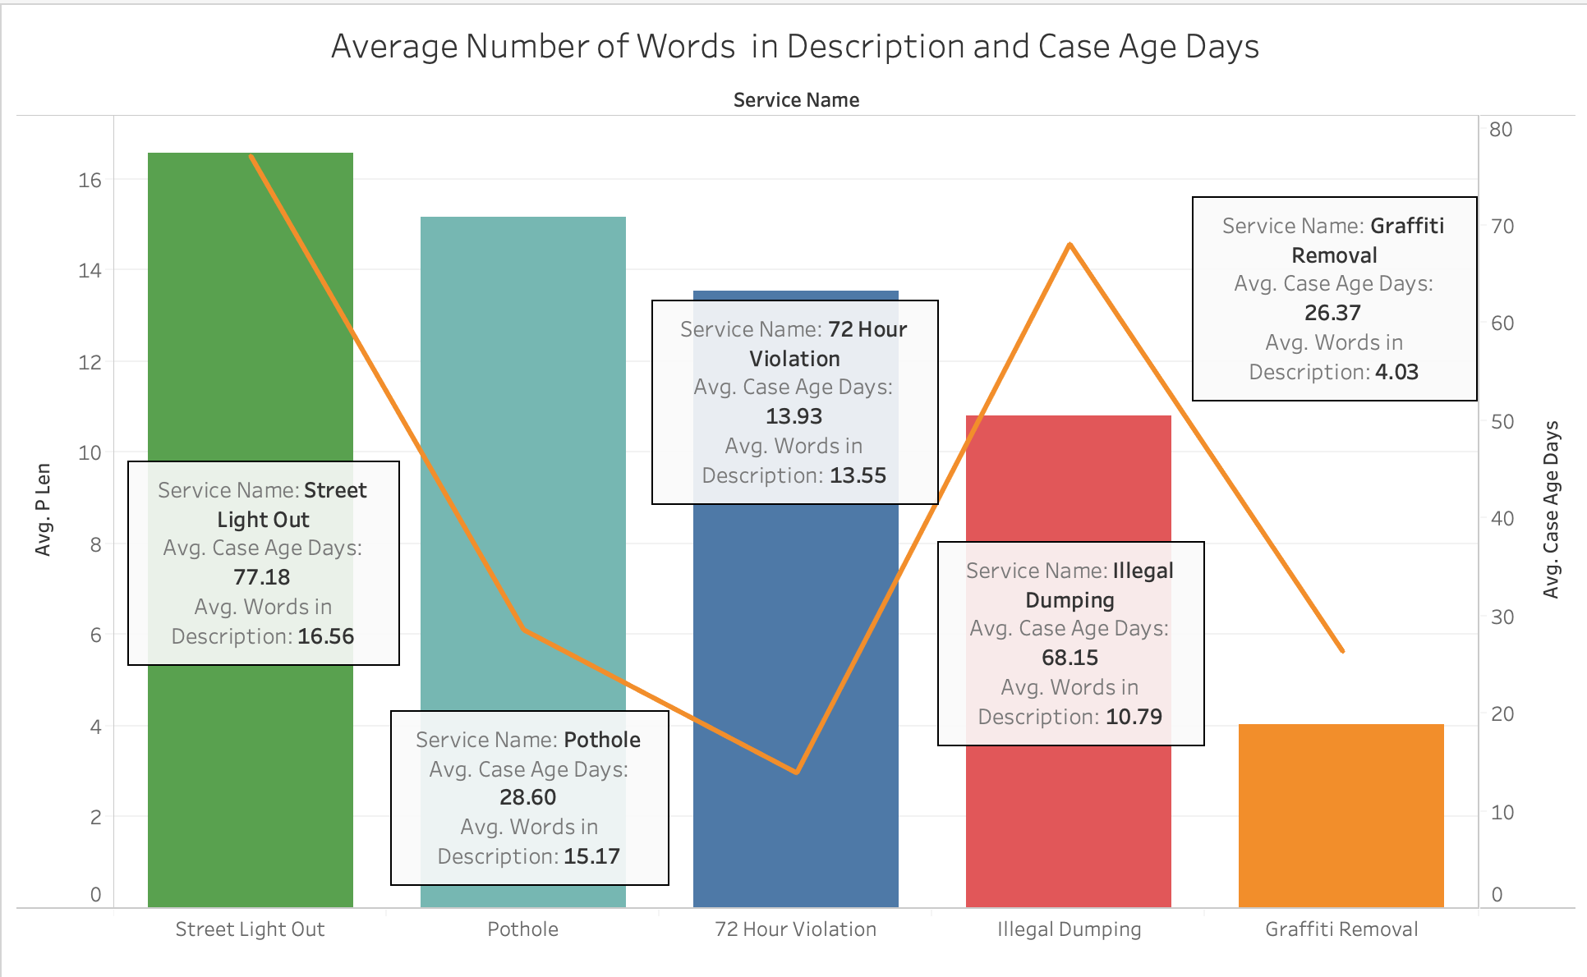
New Feature: Word Count

Slide 91
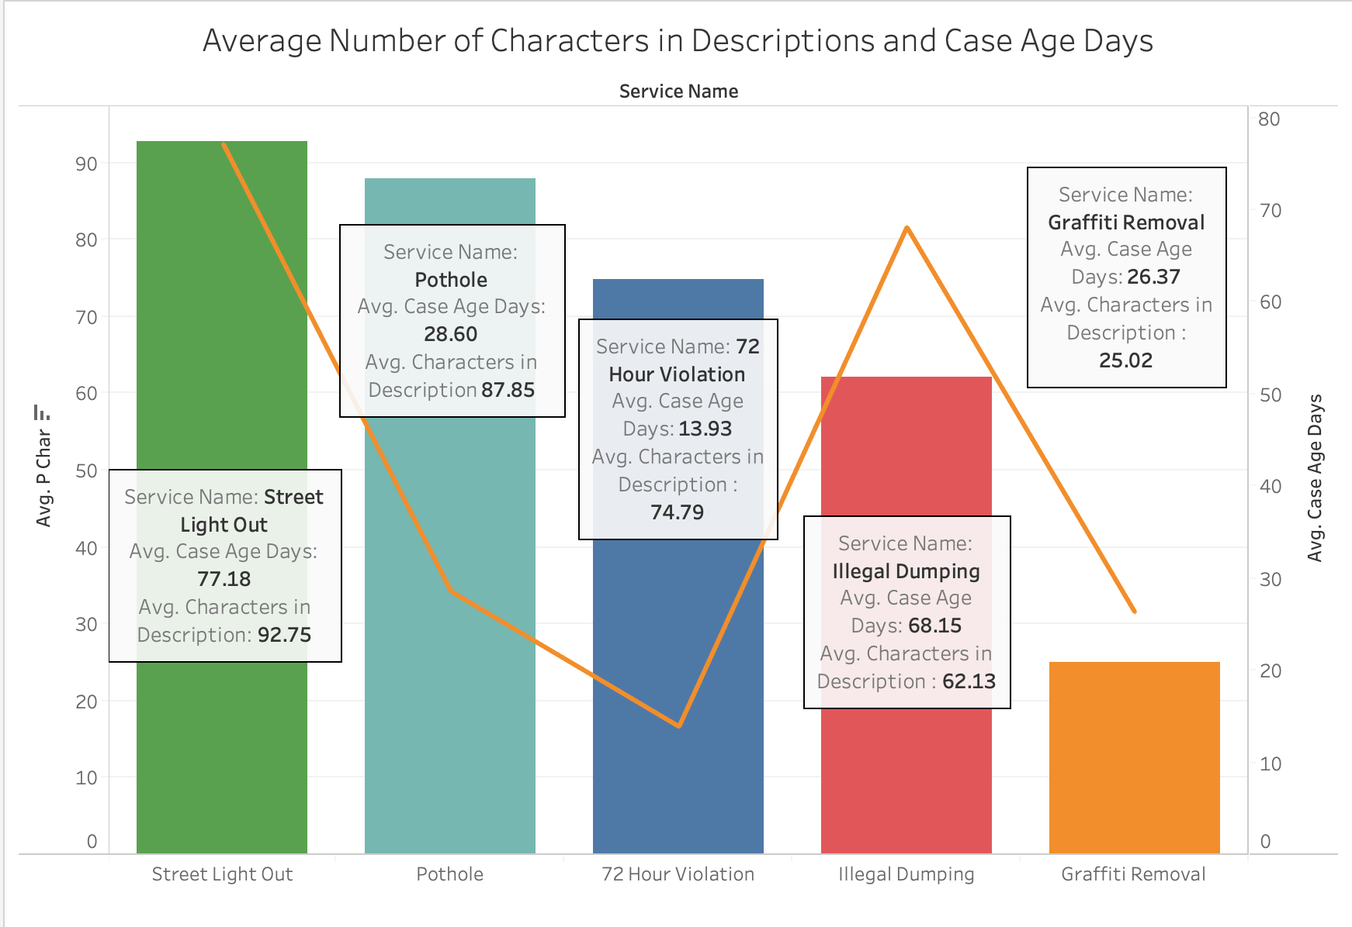
New Feature: Character Count

Slide 92
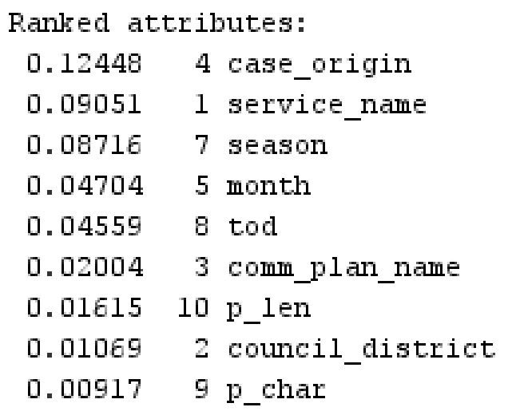

Logistic Regression - Processed
Most accurate model
Highest Recall
Most errors are in classifying short
Model
Actual

Slide 93

Random Forest - Processed
Crew/Self Generated * 2.22
Parking Zone Violation * 2.03
Tree Trimming Contract * -0.98
Storm Water Illegal Discharge * -2.84
Model
Actual
Notes:
Short - Orange
Long - Red

Slide 94
Model Comparison
Models | Before Pre-processing and FE | After Pre-Processing and FE | How much did our models improve by?
Logistic Regression | 56.25% | 73.40% | 30.49%
Random Forest | 54.75% | 73.09% | 33.49%
Notes:
So after data manipulation and some feature engineering, we improved both of our models to about 73% each which is over a 30% improvement. But what does this all mean?

